Slide 1
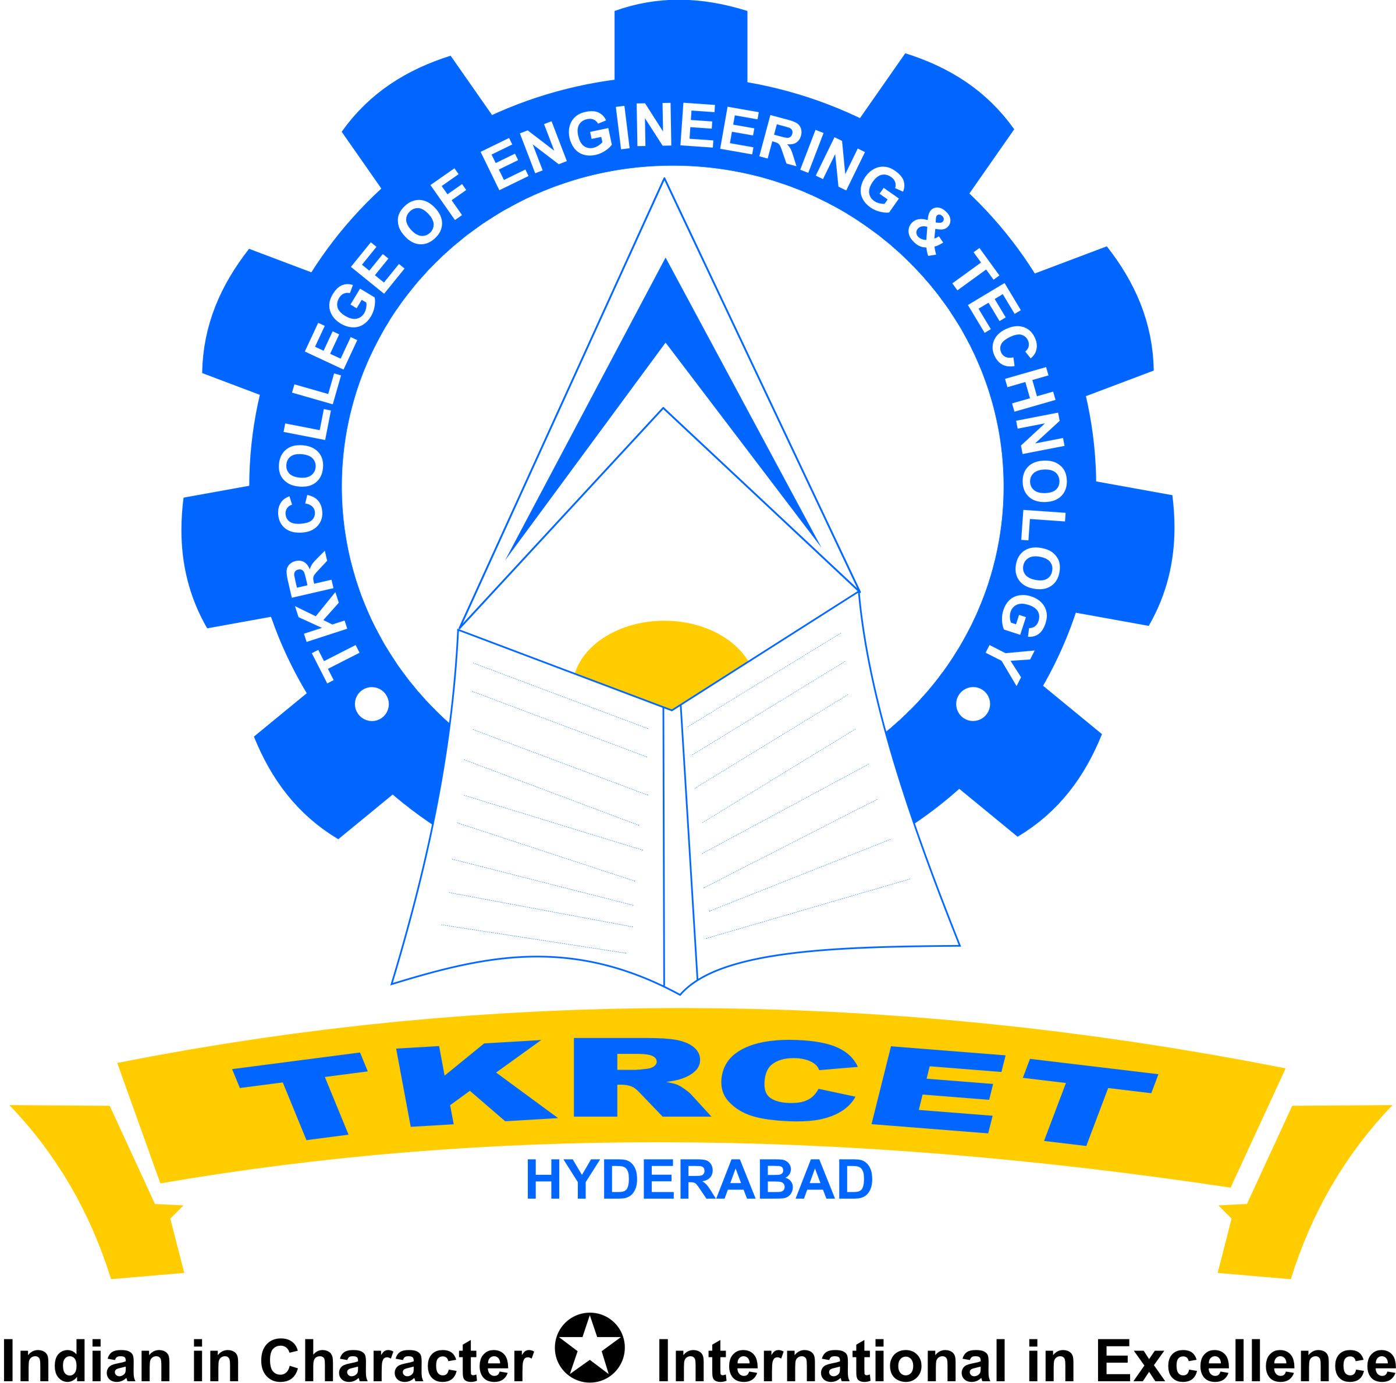
TKR College of engineering & Technology

Slide 2
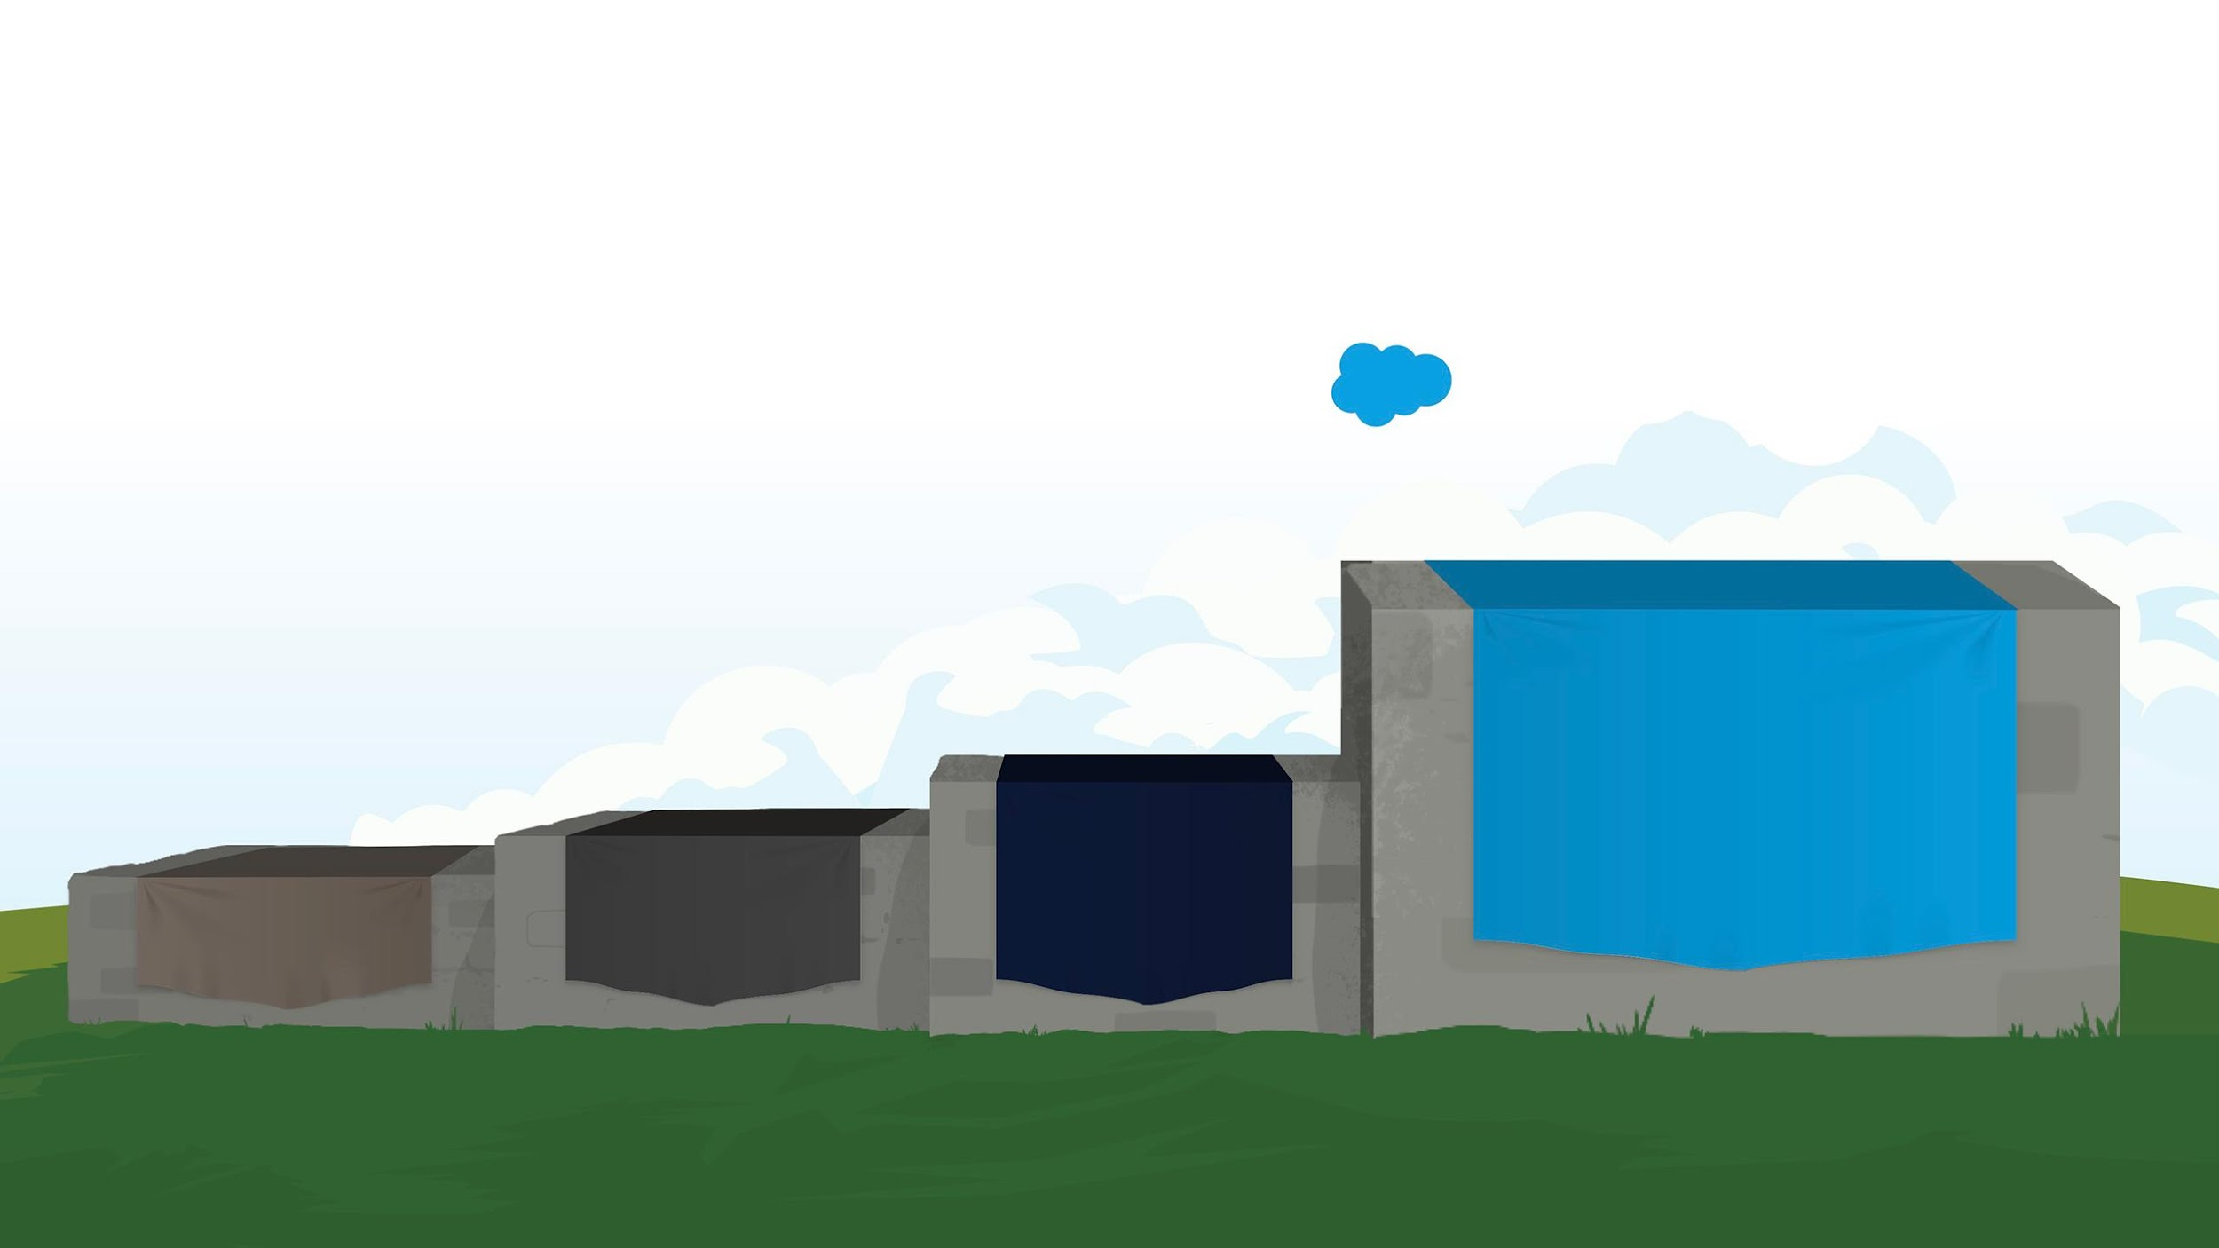
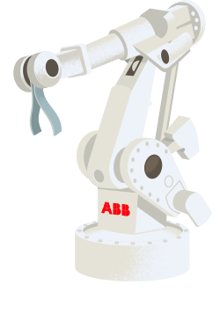





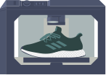






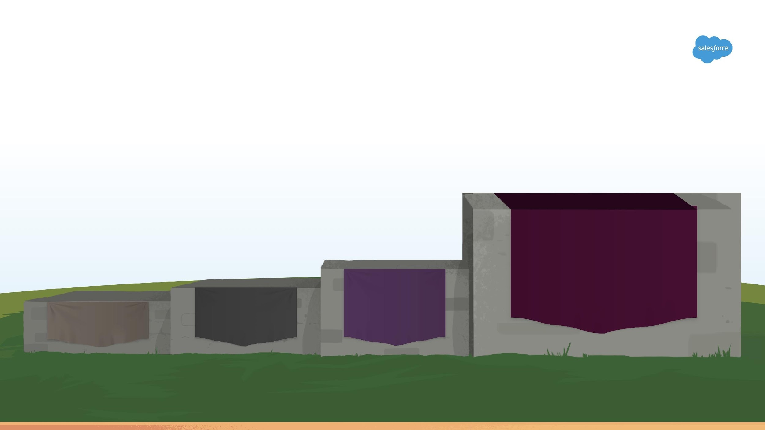
Industry Is Moving Forward
4th Industrial
Revolution with AI/ML, DS, IOT, Robotics, BIG Data, etc
3rd Industrial Revolution
2nd Industrial Revolution
1st Industrial Revolution
Steam
Electricity
Computing
Connected
1700s
1800s
1900s
Today

Slide 3
TKR college of engineering & Technology

Slide 4






TKR college of engineering & Technology
Skill Gap Between Industry and Academy
1.4M
Developer Jobs
3x
more demand for IT than are being educated
400K
Computer Science Students
Notes:
Key Messages
We’re in the midst of the fourth industrial revolution, and we need to rethink how to acquire the skills and make an opportunity
Talk Track
When we go through technological revolutions like the fourth industrial revolution, there is a direct result on the job market. In this case, a huge developer gap has ensued – not only developers, but data scientists, mobile experts, security experts, etc. How can we help solve this developer gap, which will only widen unless we start to empower people to learn and develop their skill set to thrive in the fourth industrial revolution.
How do we solve for this? Trailhead! Trailhead provides developers the skills and tools they need, but it will also empower users across the organization, from business users to admins, the ability to build applications. We’re transforming how our trailblazers build apps.

Slide 5
TKR college of engineering & Technology
Placement Statistics

Slide 6
TKR college of engineering & Technology
Key Highlights of Placements
Drives conducted through ON/OFF campus and pool campuses:- 105+ companies
Companies visited campus for conducting on-campus in campus premises:- 63+ organizations
Offers acquired by the students in ON/OFF campus:- 600+ offers
Core companies visited:- 50+
Average Salary Package:- 3.25 LPA
Minimum Salary Package:- 2.5 LPA
Maximum Salary Package:- 28 LPA

Slide 7










TKR college of engineering & Technology
Students Placed in Top Organizations

Slide 8















TKR college of engineering & Technology

Slide 9
TKR college of engineering & Technology
TKR CRT Program Highlights
CRT Programs incorporated in academic timetable for complete year.
Free online assessment portals with customized compilers provided to have hands on training for practice
Company Specific trainings provided as and when the opportunity comes from the corporate eg:- code vita, code ninja, Infosys, CTS, Virtusa etc
Interactive session with corporate HR’S
As per the AICTE Norms Internships opportunities provided for all the students
Entrepreneurship development programs
Free E-learning portal from Amazon Webservice with project deployment facility
Technology specific trainings like ServiceNow, CISCO, Oracle etc.
The CRT curriculum at TKR will also include the Internship Program, which is an institutionalized effort to bridging the gap between the professional world and the academic world. This is ensured by providing equal internship opportunities starting from 2nd Year onwards. For this T&P Cell have tied up with several organizations to leverage the internship opportunities to our students.

Slide 10
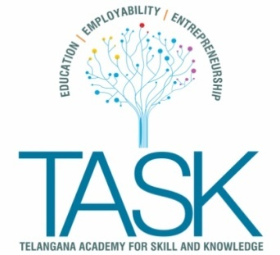


TKR college of engineering & Technology
Institutionalized MOU’s
Technology Partnerships
Industry Hiring Partner

Slide 11
TKR college of engineering & Technology
Thank You
P. Srinivas Reddy
Head- Industry & Campus Relations
mailto:srinivasreddyp@tkrcet.com
9949242459

