Slide 1






TKR COLLEGE OF ENGINEERING TECNOLOGY
MEDBOWLI MEERPET , HYDERABAD , TELANGANA
2

Slide 2
NSS Programme Officer
J.Sunitha kumari
&
G.Anitha Chowdary
NSS - AFGCW
3

Slide 3

About NSS
The scheme was launched in Gandhiji's
Centenary year-1969.
Aimed at developing student's personality through community service.
NSS is a voluntary association of young people in Colleges, Universities and at +2 level.
The cardinal principle of the NSS programme is to get a sense of involvement in the task of Nation Building.
Organized by the students and teachers through their combined participation in
community service.
NSS - AFGCW
4

Slide 4

Objectives
To enable the students to understand the community in which they work.
To understand themselves in relation to
their community.
To identify the needs and problems of the community and the solution to them.
To develop competence required for
group living and sharing responsibilities.
To acquire leadership qualities and democratic attitude.
To encourage national integration and develop the capacity to meet emergencies and national disasters.
NSS - AFGCW
5

Slide 5

NSS Motto:
The motto or watchword of the National Service Scheme is 'NOT ME BUT YOU'.
This reflects the essence of democratic living and upholds the need for selfless service and appreciation of the other person's point of view and also to show consideration for fellow human beings.
The aim of NSS is to demonstrate this motto in day-to-day programmes.
NSS - AFGCW 6

Slide 6

NSS Badge:

Slide 7

NSS Badge:
The Konark wheel in the symbol has eight bars which represent the 24 hours of the day.
The badge reminds the wearer to be in readiness for service of the nation round the clock i.e. , for 24 hours.
The Red colour in the badge indicates the NSS volunteers boldness i.e. liveliness, activeness, energetic and full of high spirit.
The navy blue colour indicates the cosmos of which the NSS is a tiny part, ready to contribute its share for the welfare of the mankind.^{NSS - AFGCW 7}

Slide 8

NSS Day:
The birth centenary year of the Father
of the Nation-1969.
NSS was formally launched on 24th
September, 1969.
24th September is celebrated every year as NSS Day with various programmes and activities.
NSS - AFGCW
8

Slide 9
NSS ACTIVITIES
REGULAR ACTIVITIES
SPECIAL CAMP ACTIVITES

Slide 10

Regular Activities
On Health Awareness.
To Conduct Awareness and Personality Development Programmes.
Awareness on Swatch Bharath.
Road Safety rules Awareness.
Orientation Programmes.
Environmental Awareness.
NSS - AFGCW
10

Slide 11
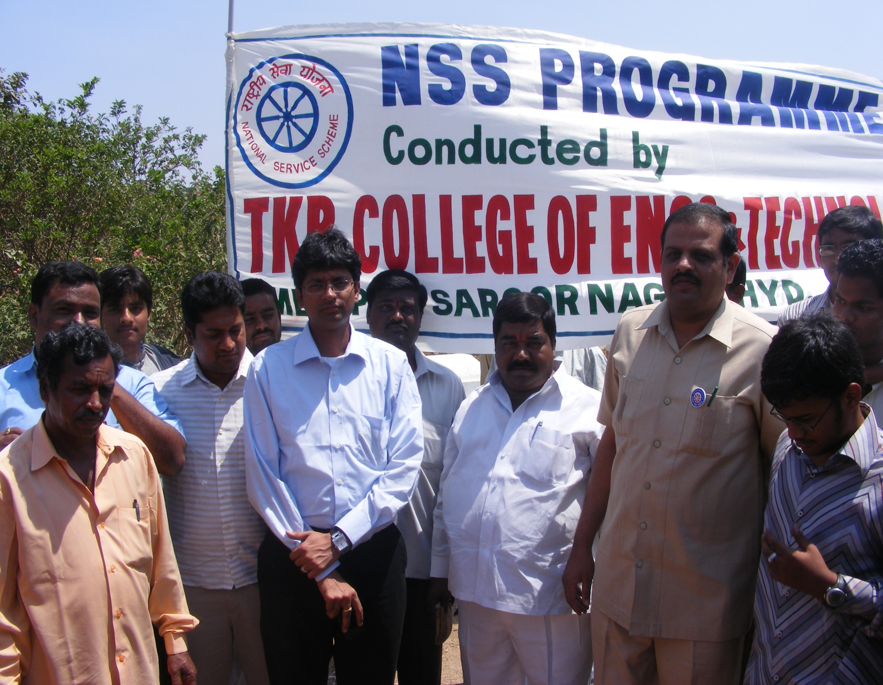
Regular Activities

Slide 12

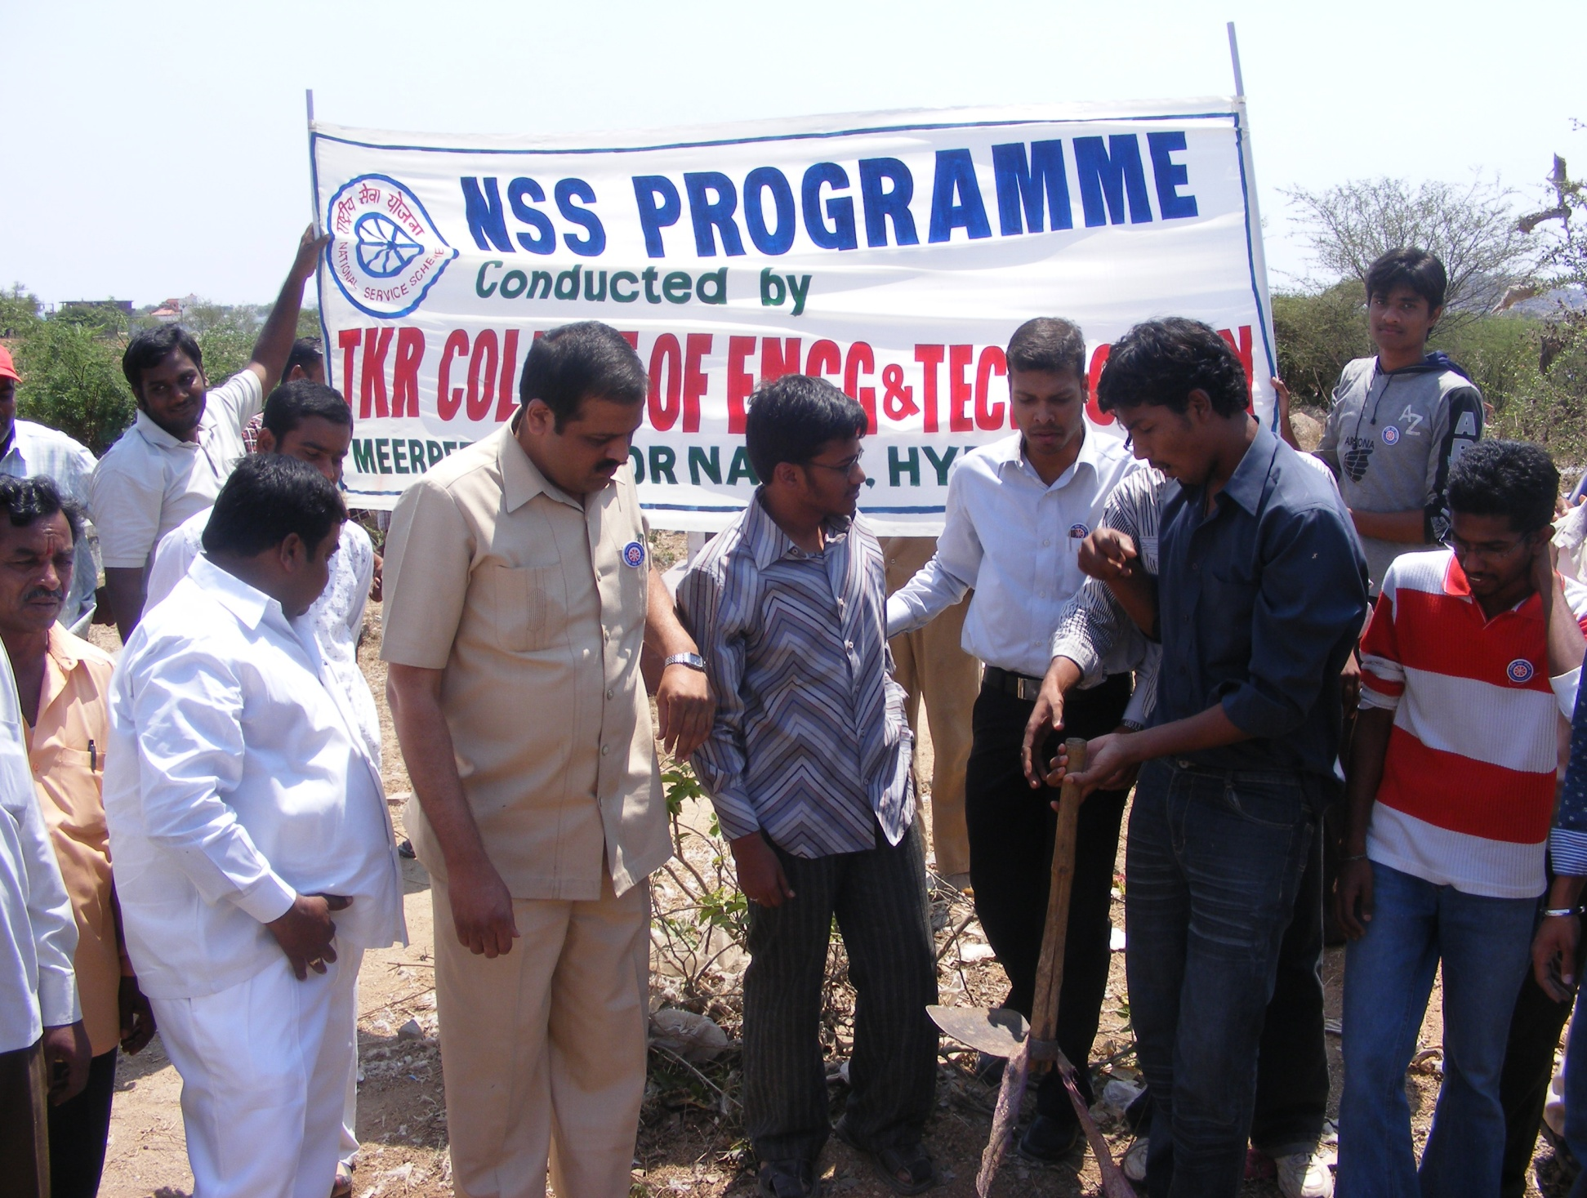
Regular Activities
NSS - AFGCW 11

Slide 13
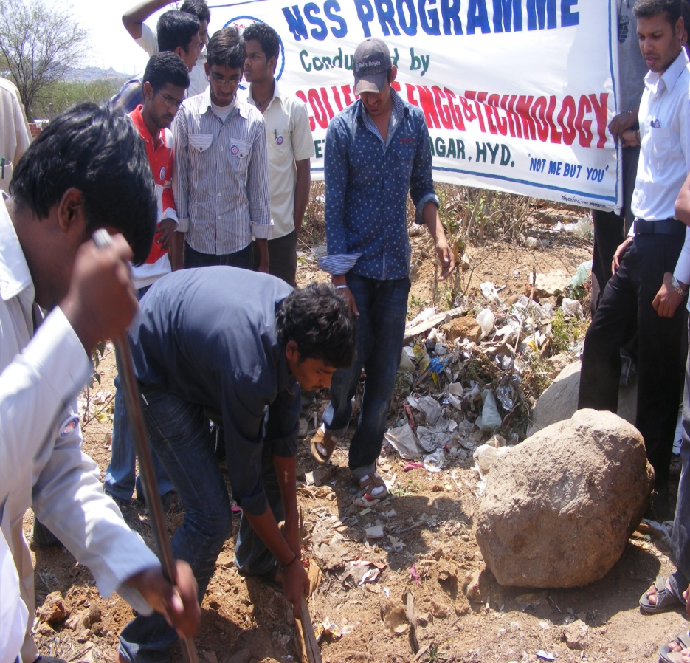
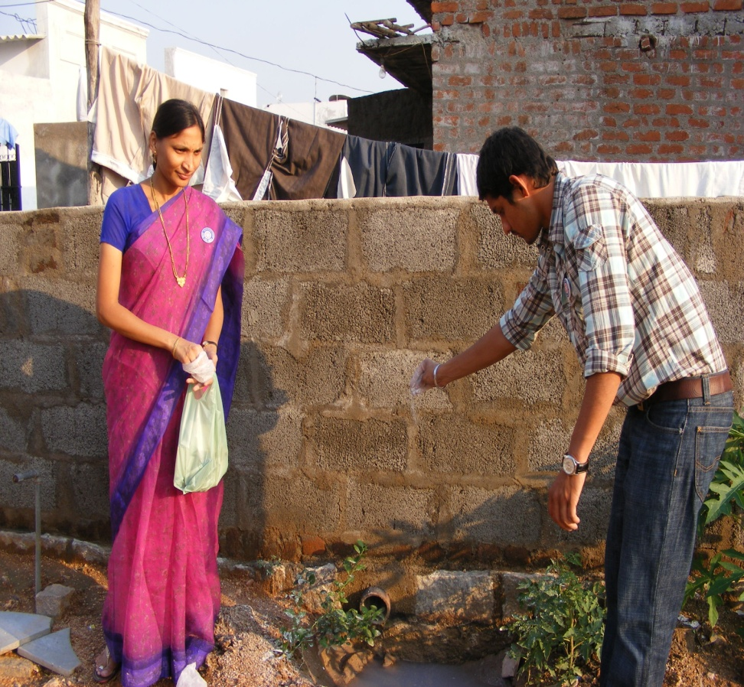
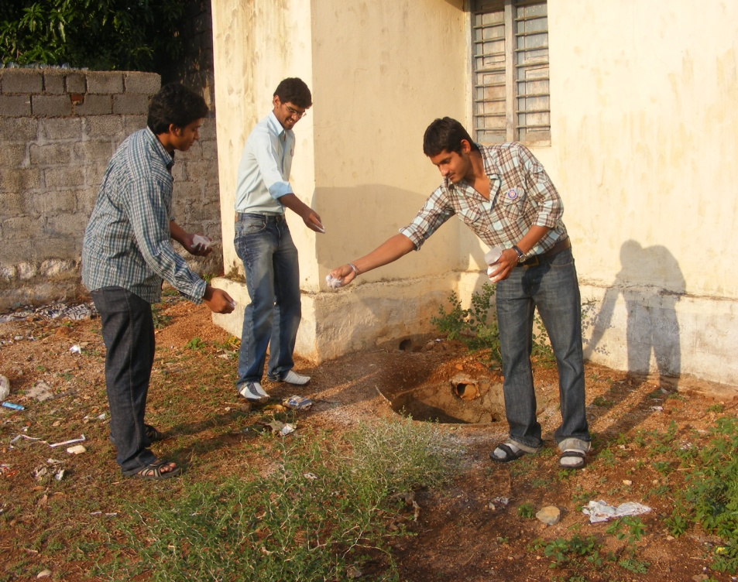
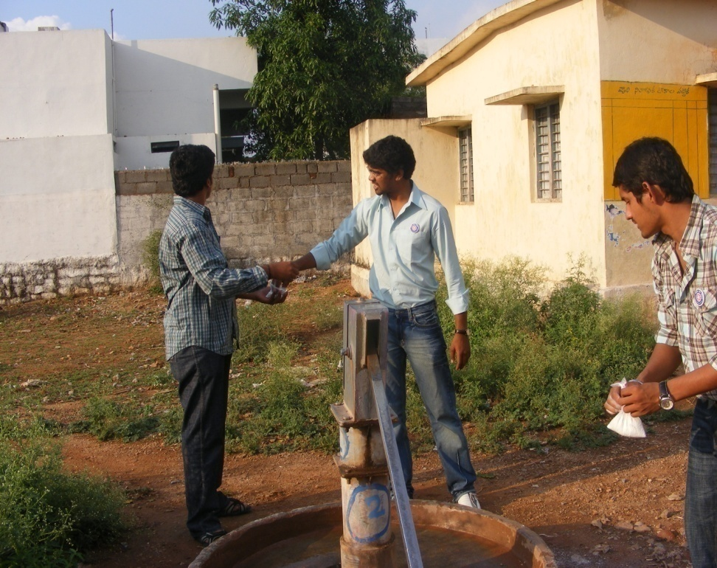

Slide 14

Special Activities
NSS Special Camps conducted every
year.
To improve the students personality and make them to participate in social activities.
To create health awareness.
Eradication of social evils.
Community service and development.
To develop leadership qualities.
NSS - AFGCW
12

Slide 15
PROGRAMMES OF NSS
Regular Activities
Orientation to NSS volunteers
Campus work
Activities in the Rural/Urban Community
Institutional work in collaboration with
voluntary organizations
Intervention during natural
calamities and national emergencies
Observance of important days
.

Slide 16
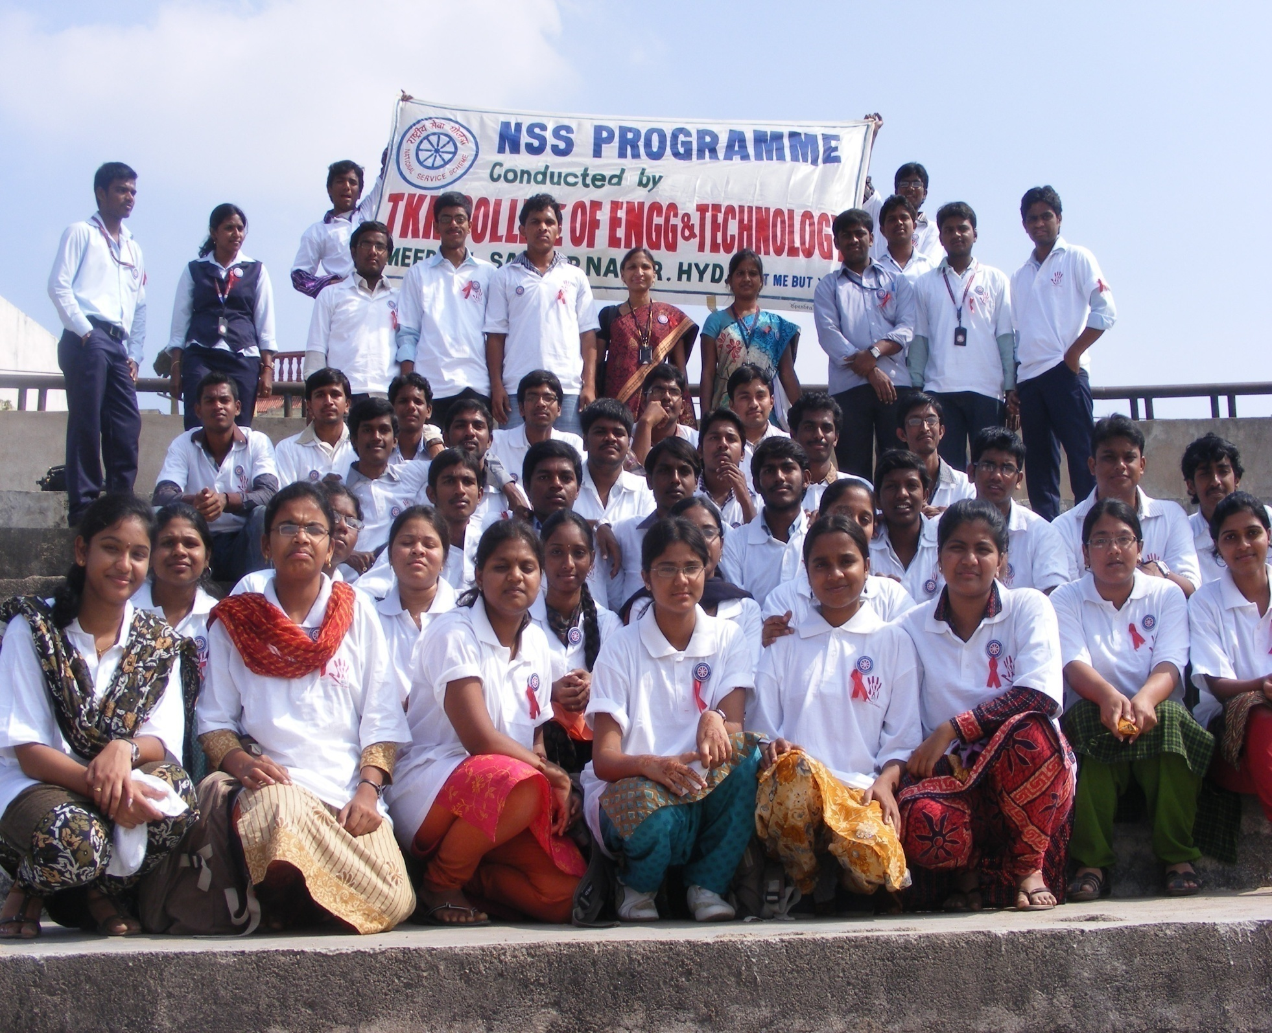

Slide 17
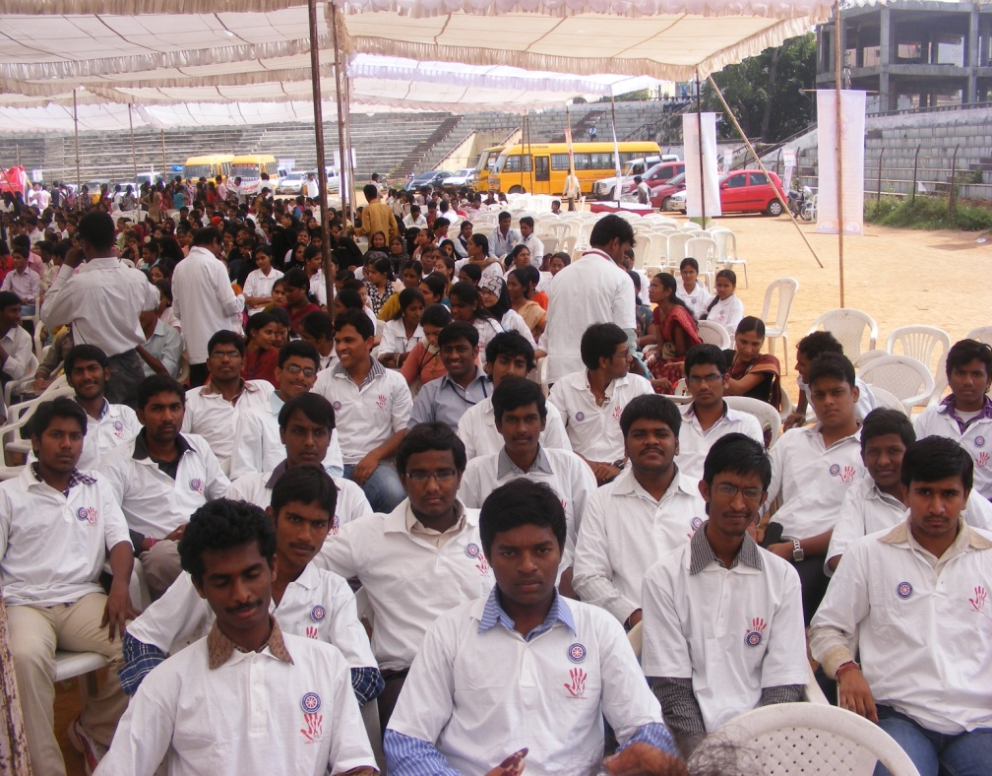
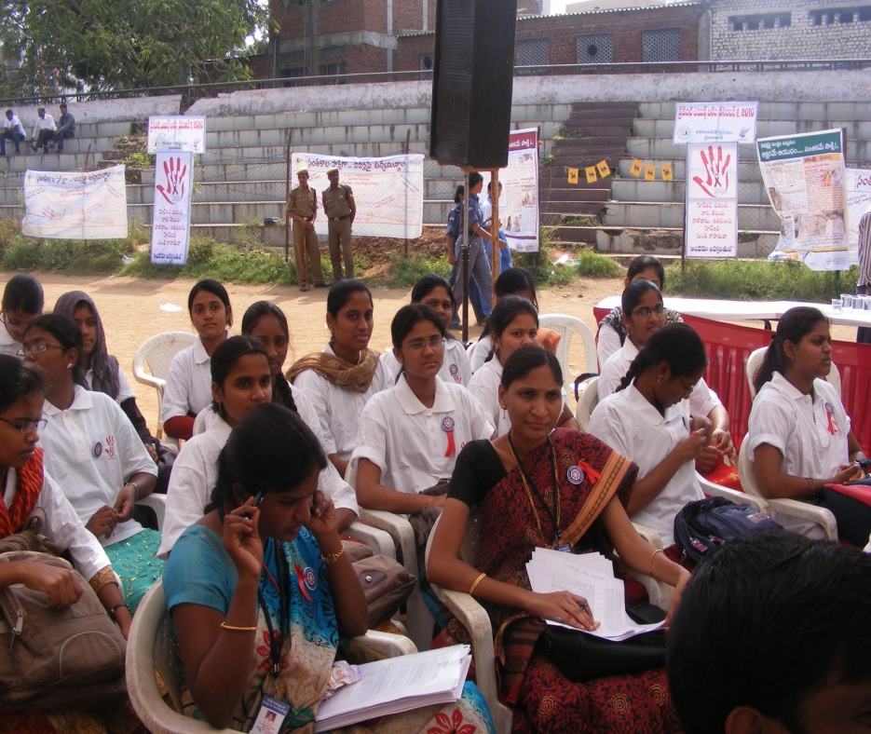
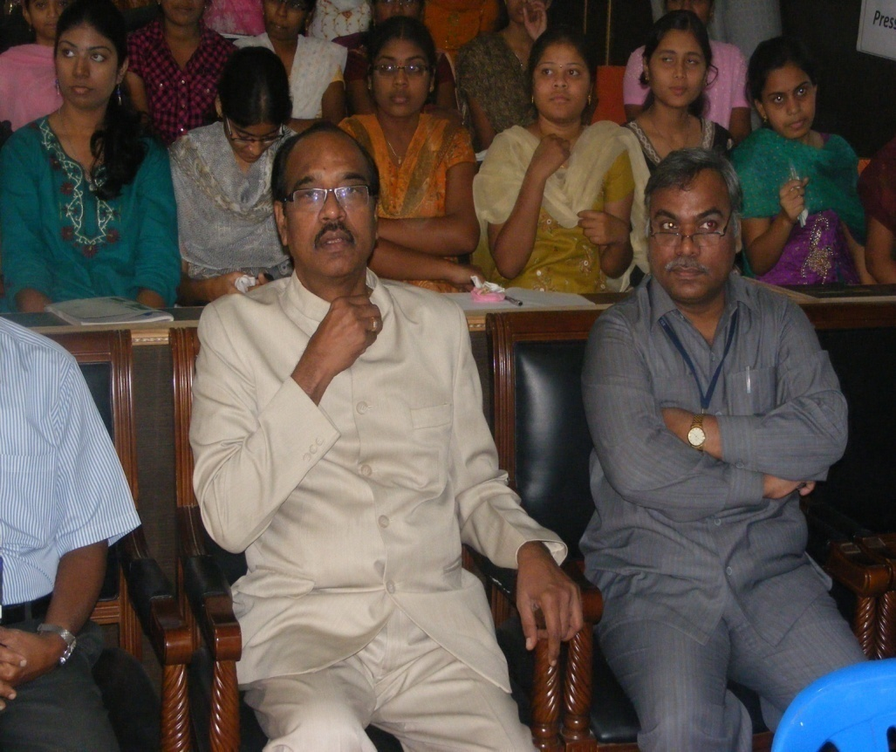
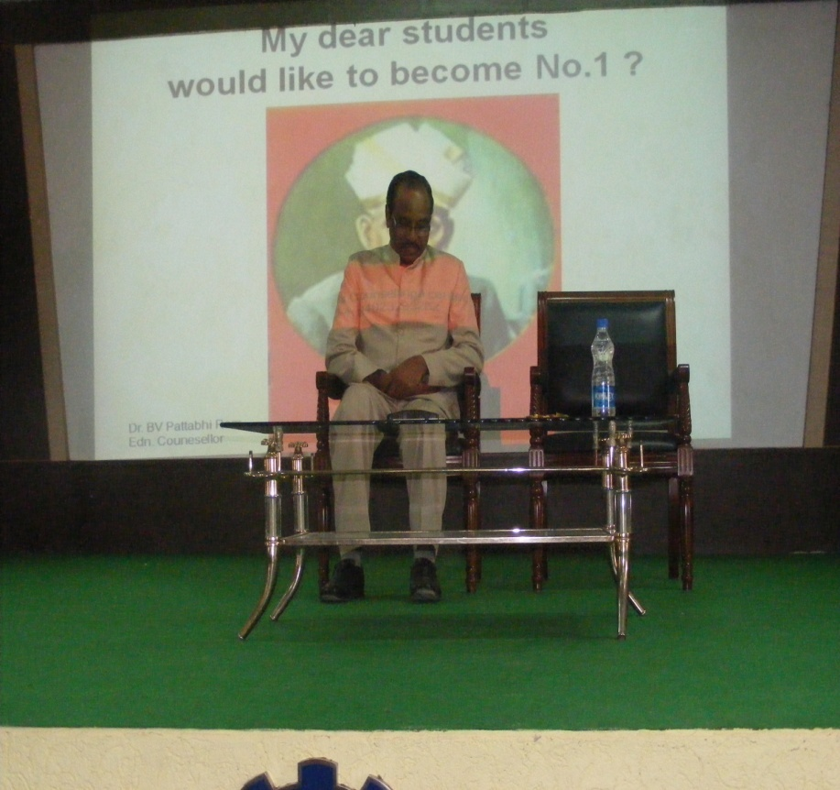

Slide 18
2. Special Camping Programme
7 days Special camp in adopted villages or urban slums based on specific themes.
Creation of Social Assets(Road, house, play ground, library etc.)
Community surveys/Minor studies.
House visits.
Cultural exchange.
Awareness programmes.

Slide 19
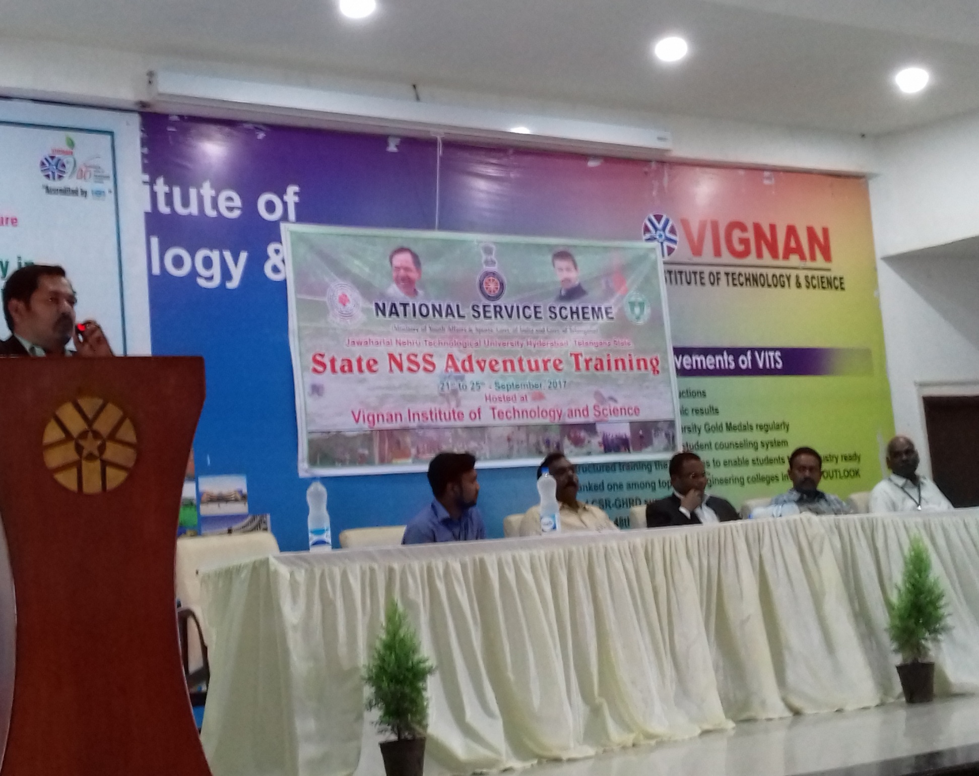

Slide 20
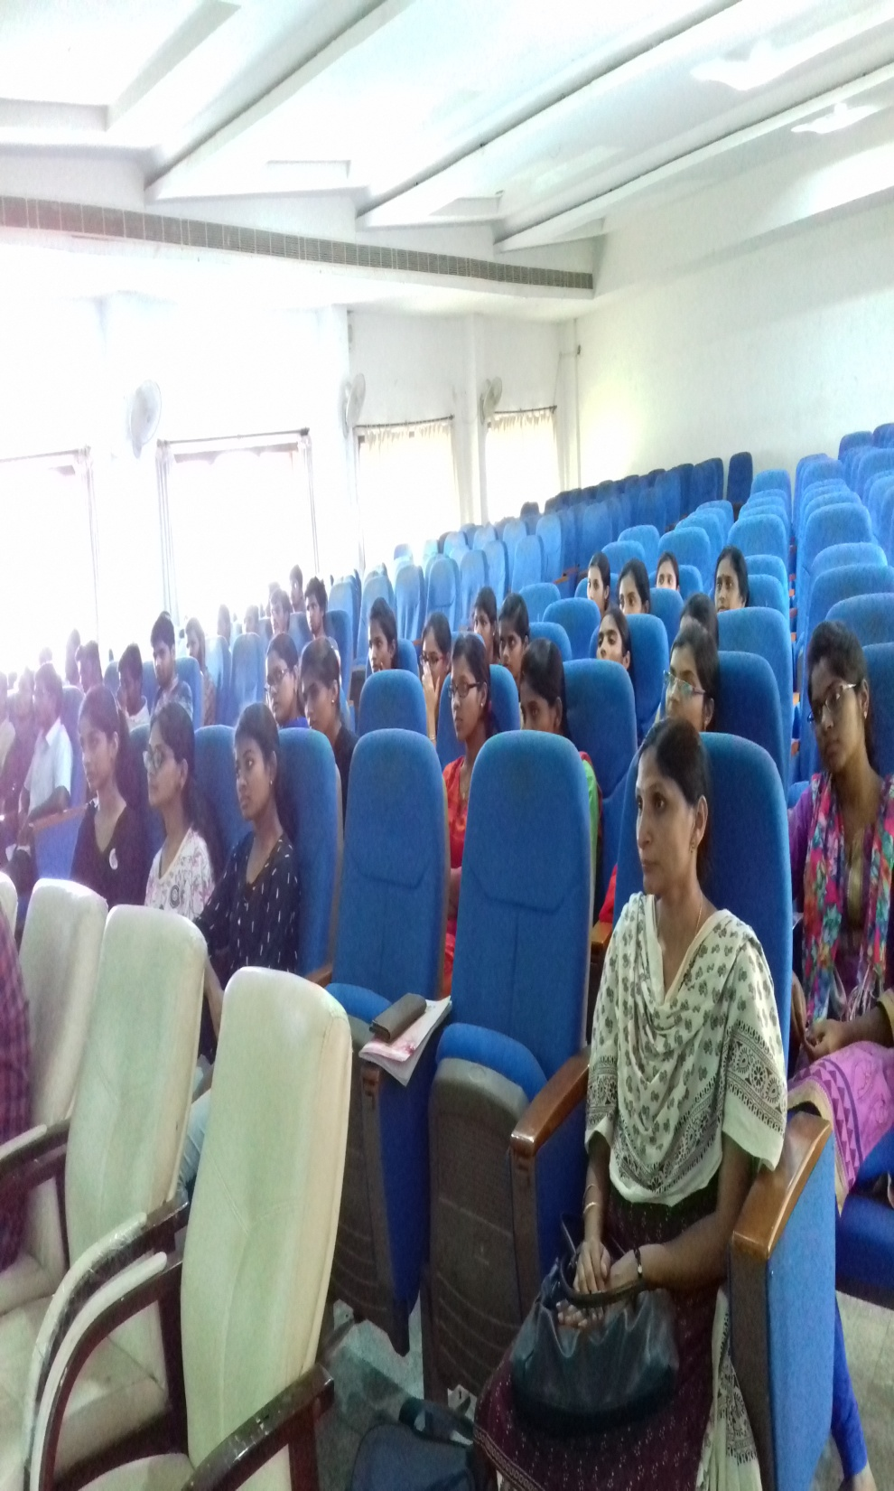
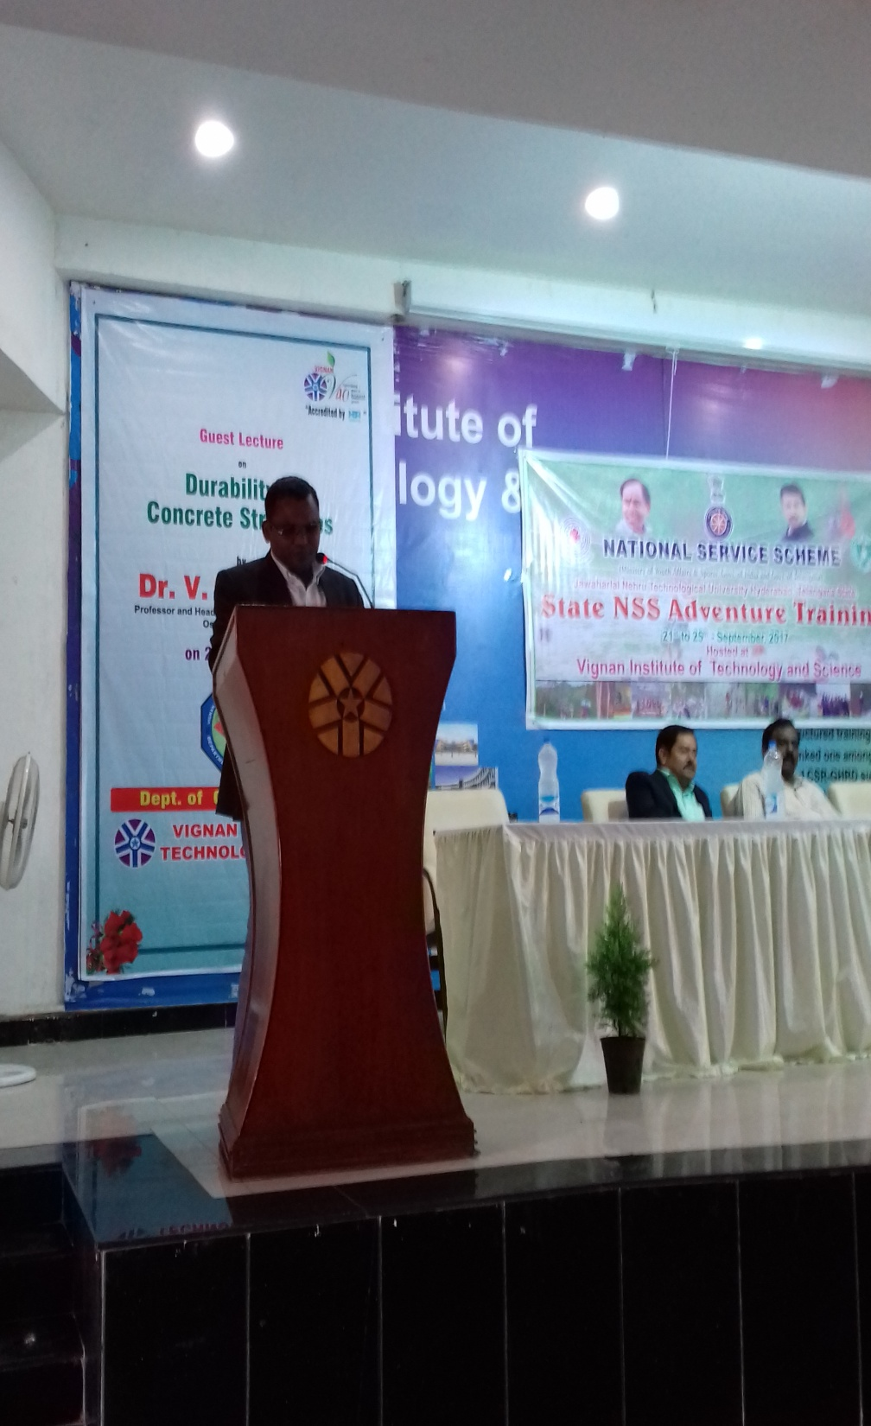

Slide 21
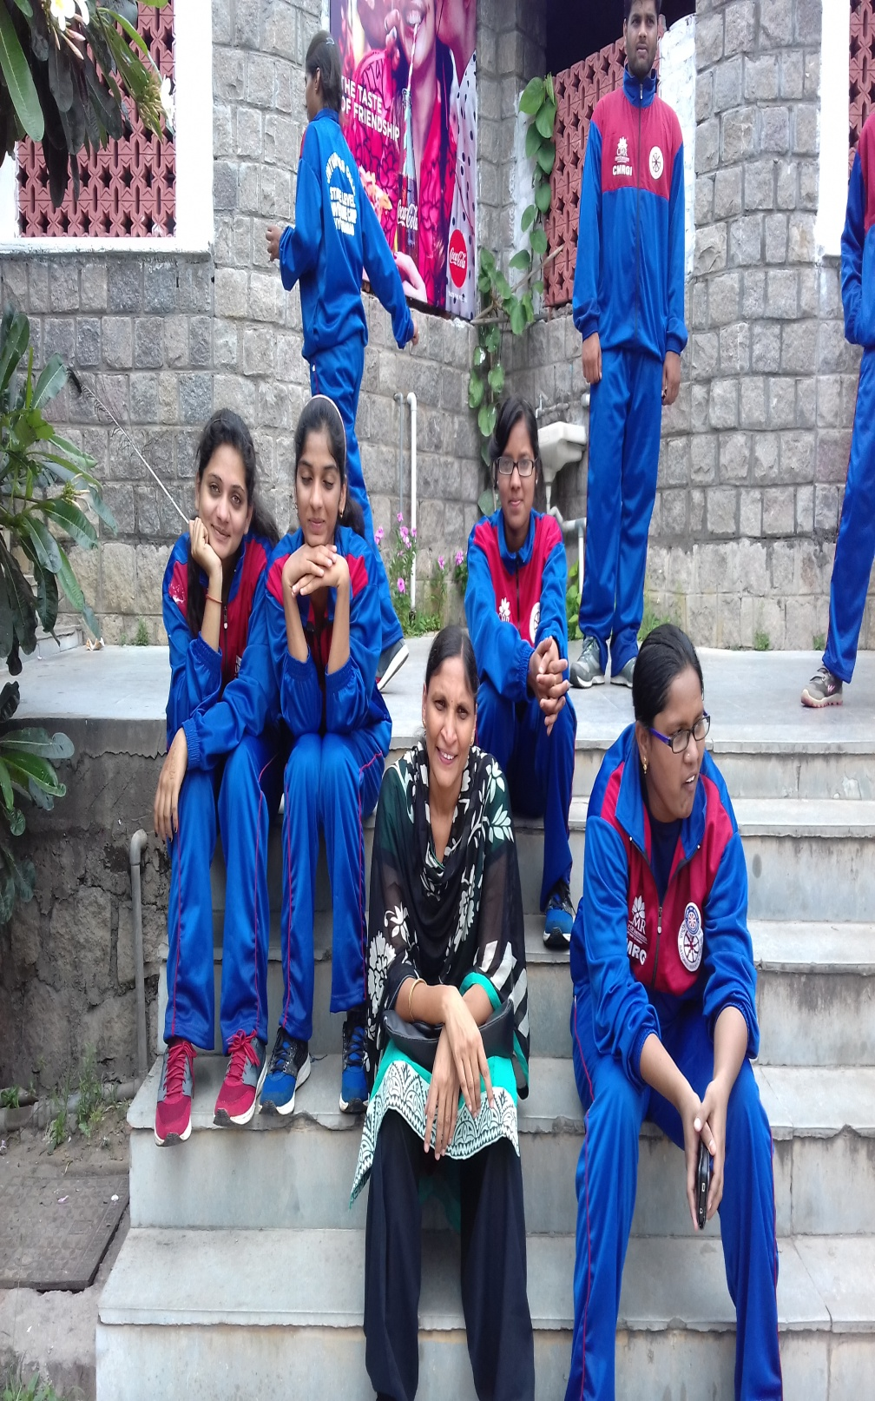
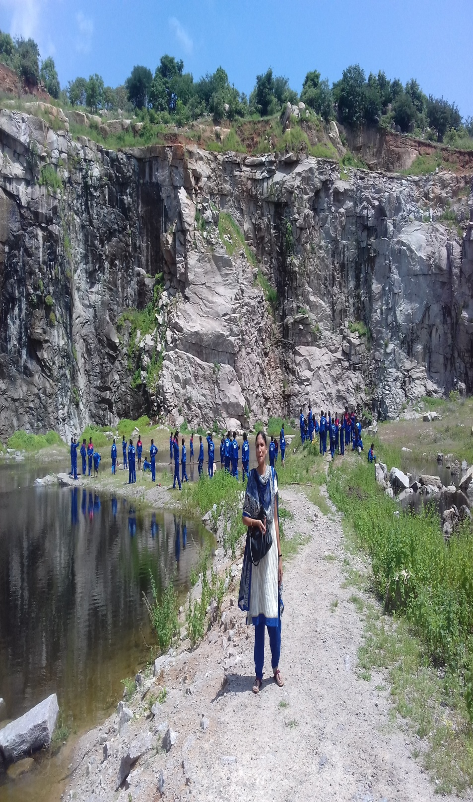

Slide 22
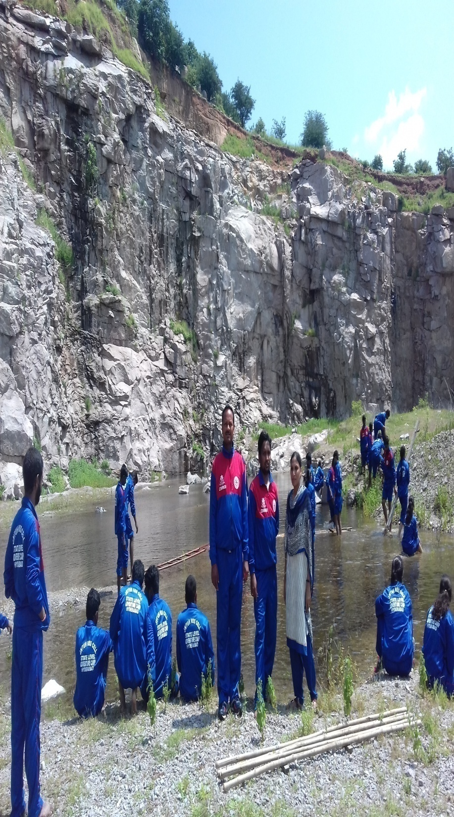
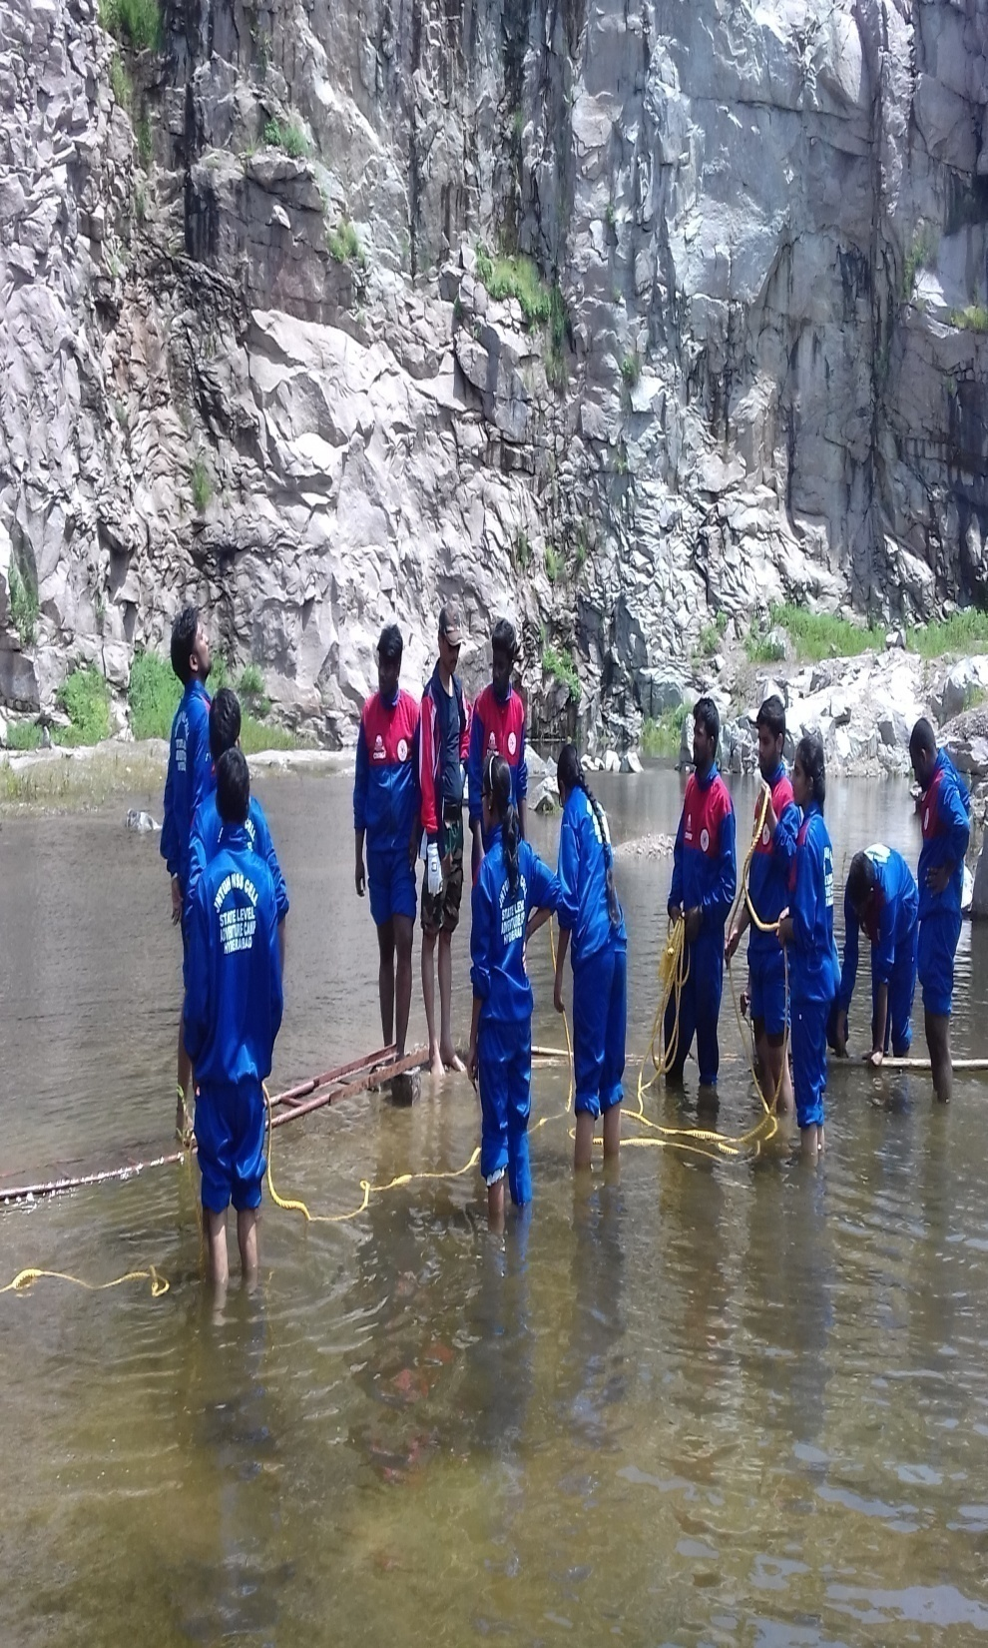

Slide 23
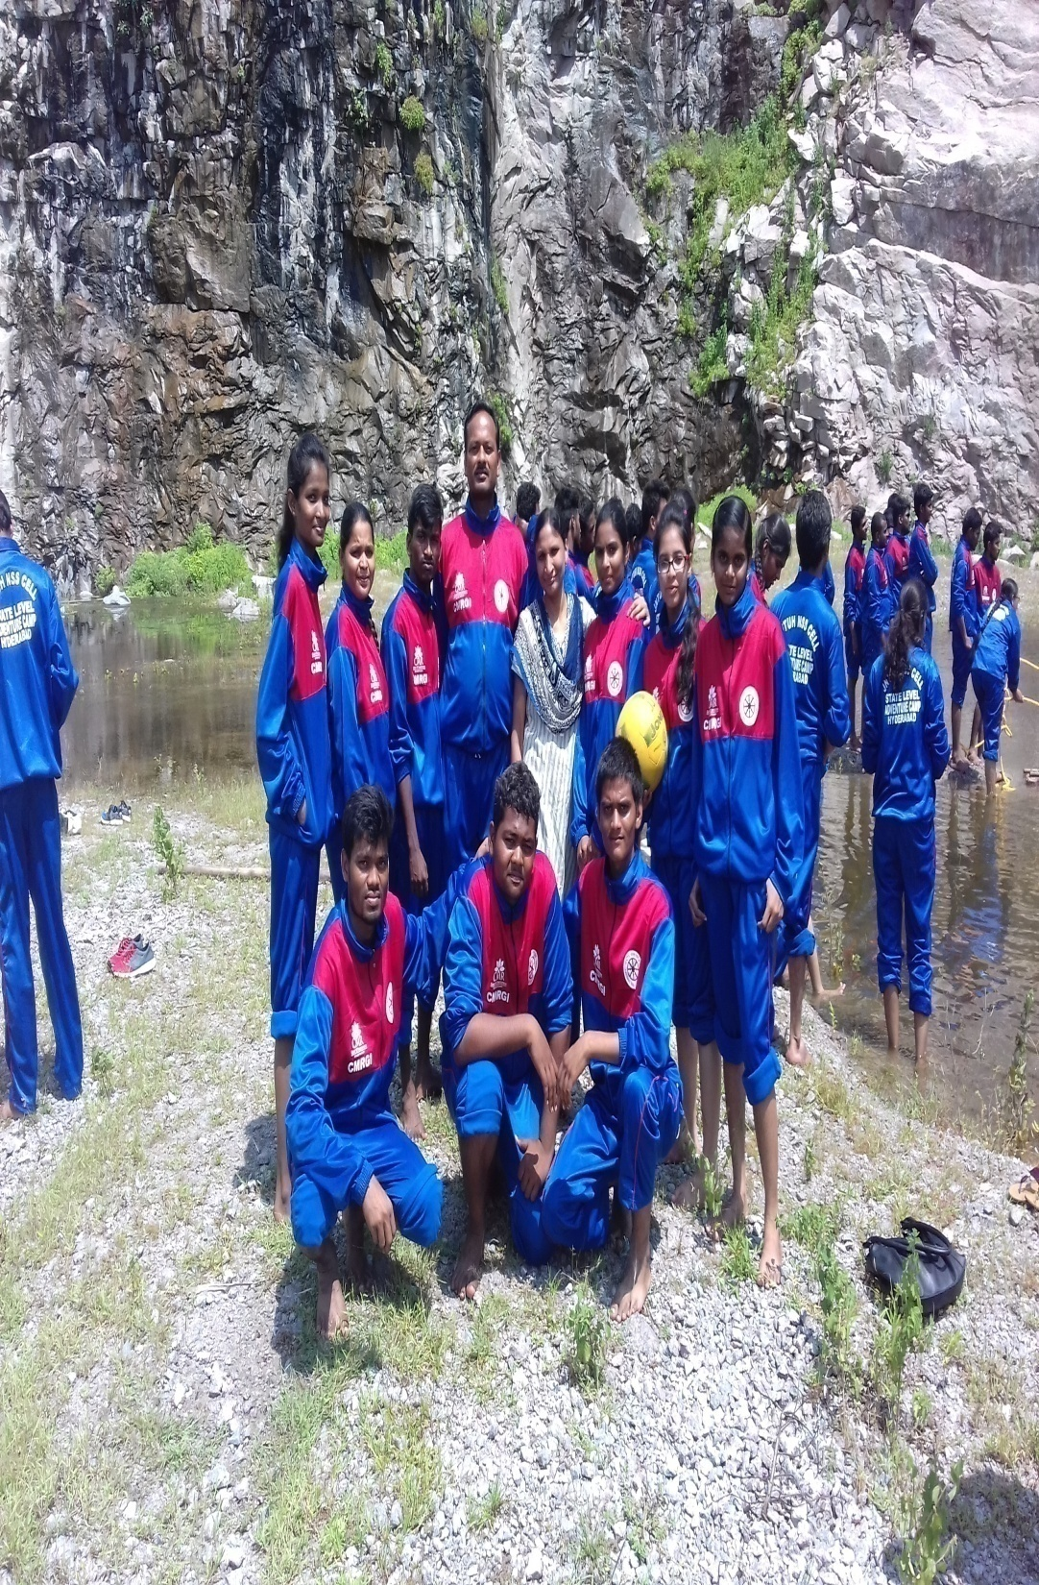
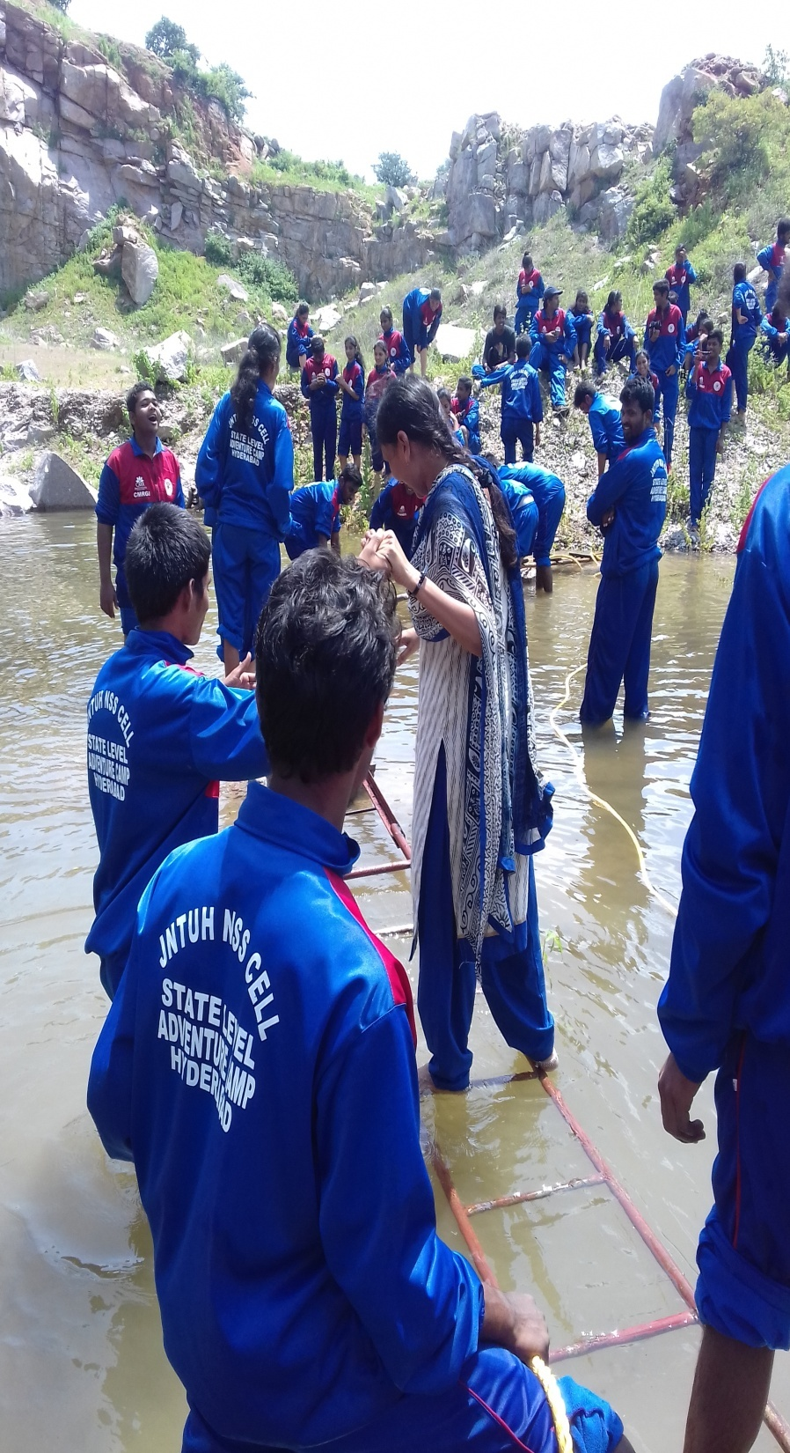

Slide 24

Regular activities
2013-14
  A “Health and Wellness” programme was organized by NSS Unit in collaboration with National Institute of Nutrition on 16th July, 2013.
  NSS Unit, TKRCET voluntarily visited an Orphanage “Happy Care Foundation” and helped them by raising funds from students and staff of the college. An amount of Rs. 11254/- was handed over to the in-charge of the Orphanage on 18.02.2014.
  A fund raising camp was organized by the NSS unit to help a chand pasha, attender mechanical Department as he met with an accident and got injured seriously by carrying Hundi’s to all the staff and students of the college. An amount of Rs.40,000/- was handed over to his Wife on 15-03-2014.
  A program on road safety and traffic control was organized by Honda Motor Cycle, India Pvt Ltd. on 23rd Jan, 2014 in the Cricket Ground of TKRCET.
24

Slide 25
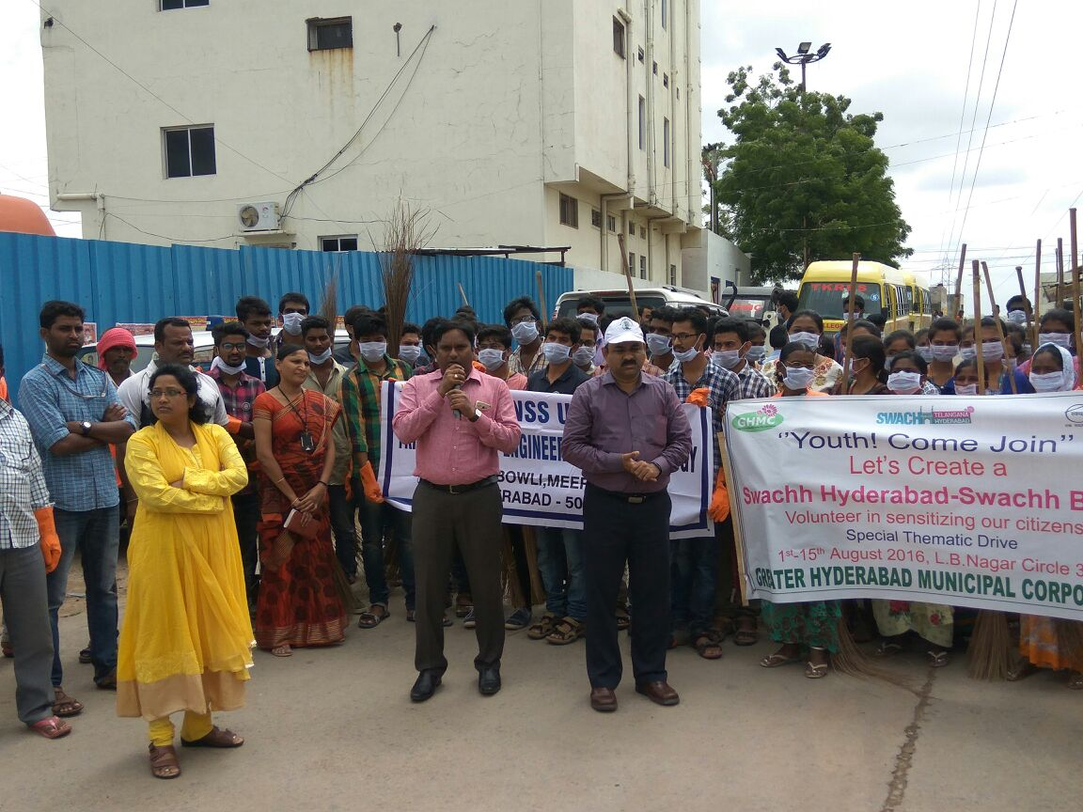
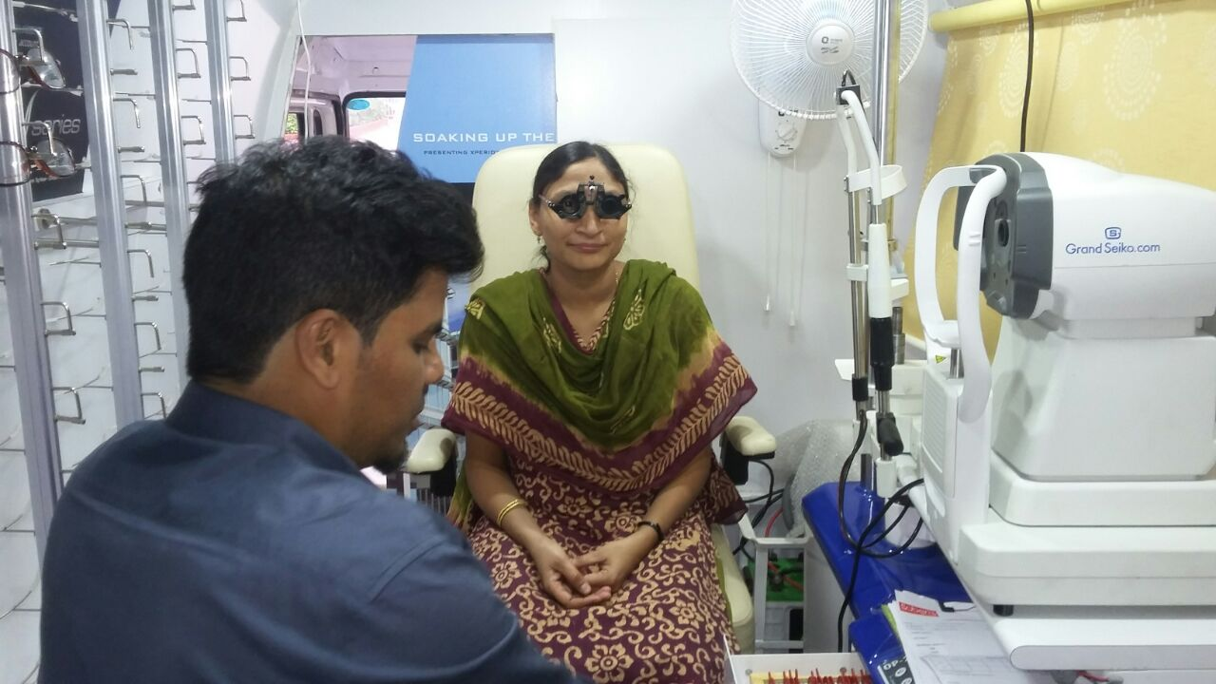

Slide 26
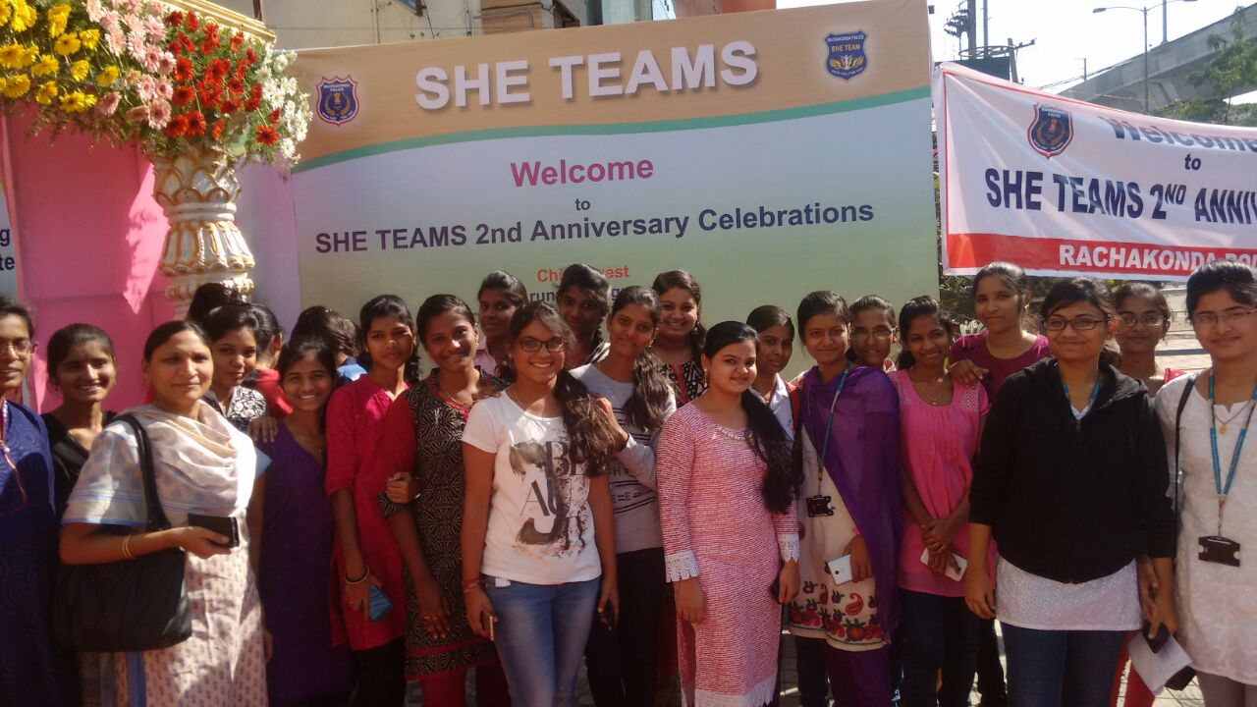
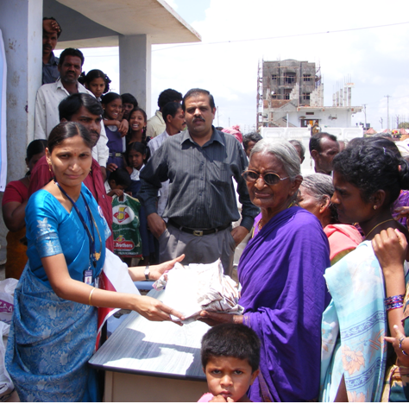

Slide 27
2014-15
NSS Unit TKRCET collected clothes from staff and students and handed over to the poor in the nearby slum area 10th July, 2014.
An amount of Rs.7500/- sent to Indian Association for the blind on account of International white cane day for which we received champions 2015 silver zone award on 31st Jan, 2015.
A Blood donation camp was organized in association with the heartily care foundation on 21st Oct, 2014 and 132 samples were donated.
A Fund of Rs.40,000/- was raised for helping the victims of hud-hud cyclone victims of Visakhapatnam by carrying the hundis to each class room and was handed over to Eenadu on 27th Nov, 2014.

Slide 28


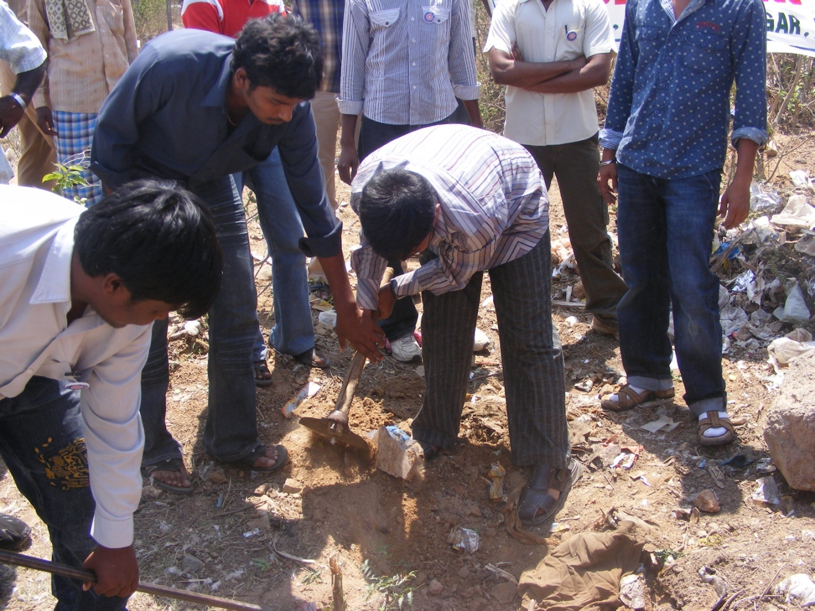
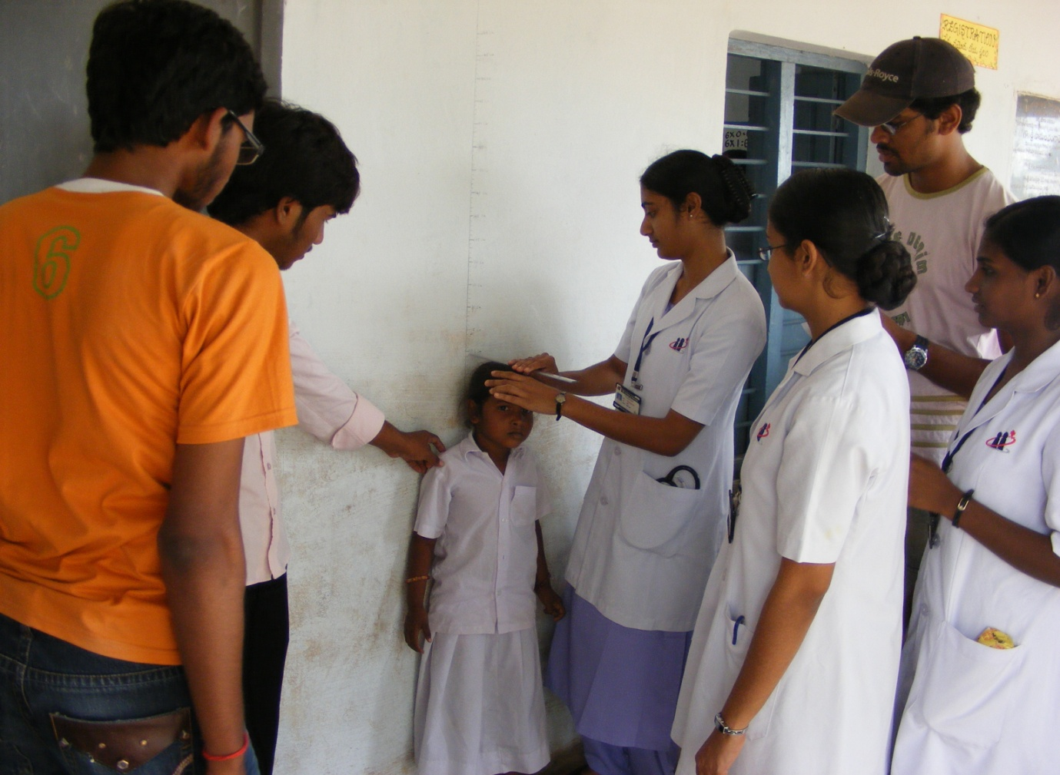
NSS Volunteers Participation
25

Slide 29
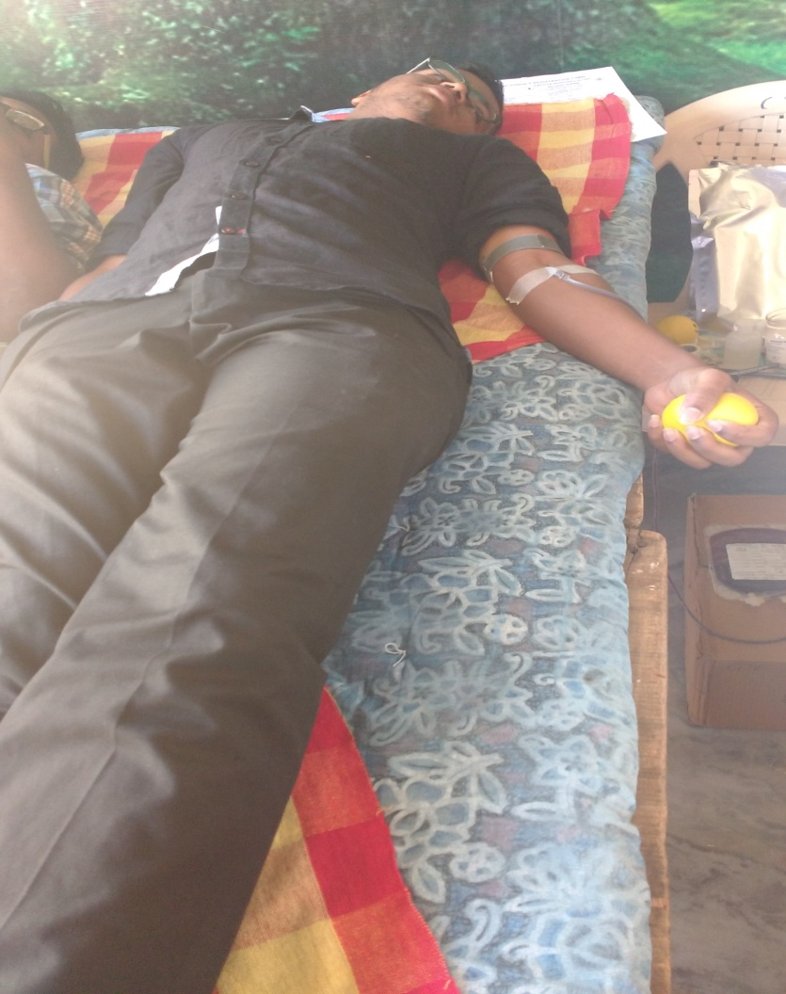
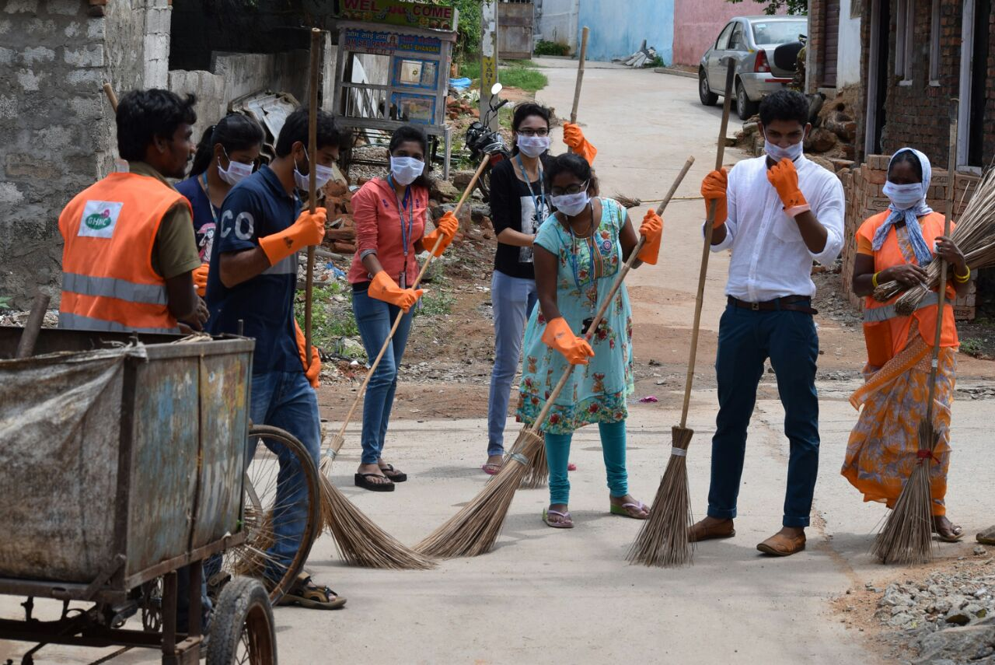

Slide 30
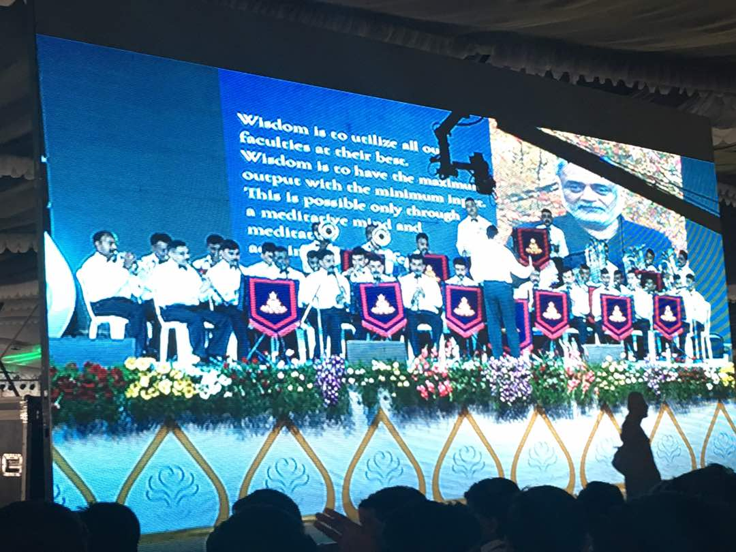

Slide 31
      2015-2016
      On 14th Aug 2015 a plantation programme was conducted by NSS Unit TKRCET at Hasthinapuram.
      On account of Swacch Bharath, a Swacch meerpet programme was organized on 4th Sep 2015.
      An amount of Rs.10,000/- was sent to Indian Association for the blind on account of International white cane day on 14th Dec, 2015.
      On 2nd Oct, 2015 the NSS volunteers participated in a progamme where Gandhi Jayanthi was promoted as khadhi day at Necklace road.
      On 7th Feb , 2016 the NSS volunteers participated in CANCER awareness walk was organised by Yashoda hospitals at INDOOR Stadium , L.B Nagar to Dilsuknagar.

Slide 32

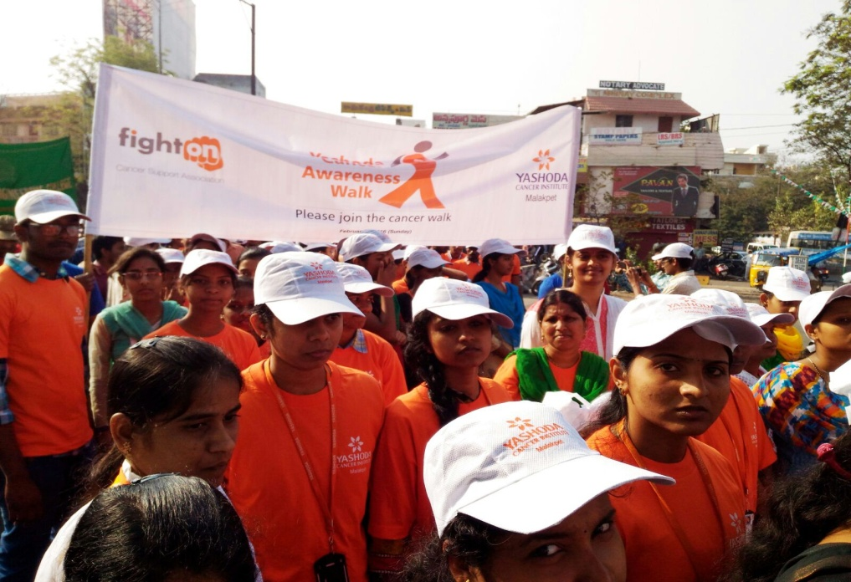
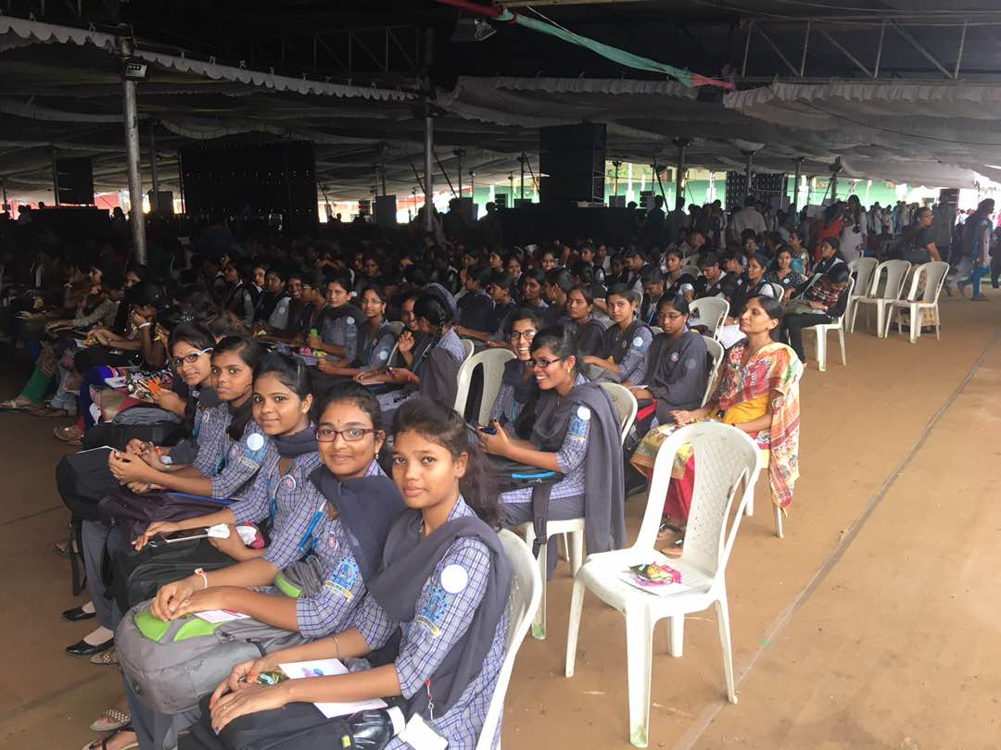
HIV/AIDS Awareness Activities
26

Slide 33
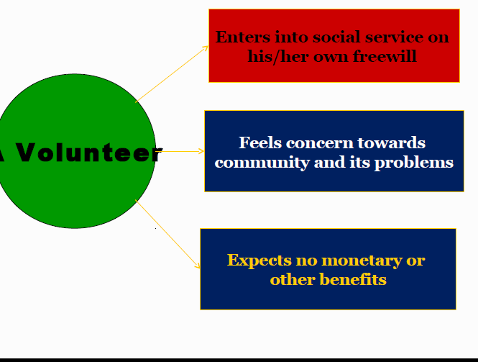

Slide 34
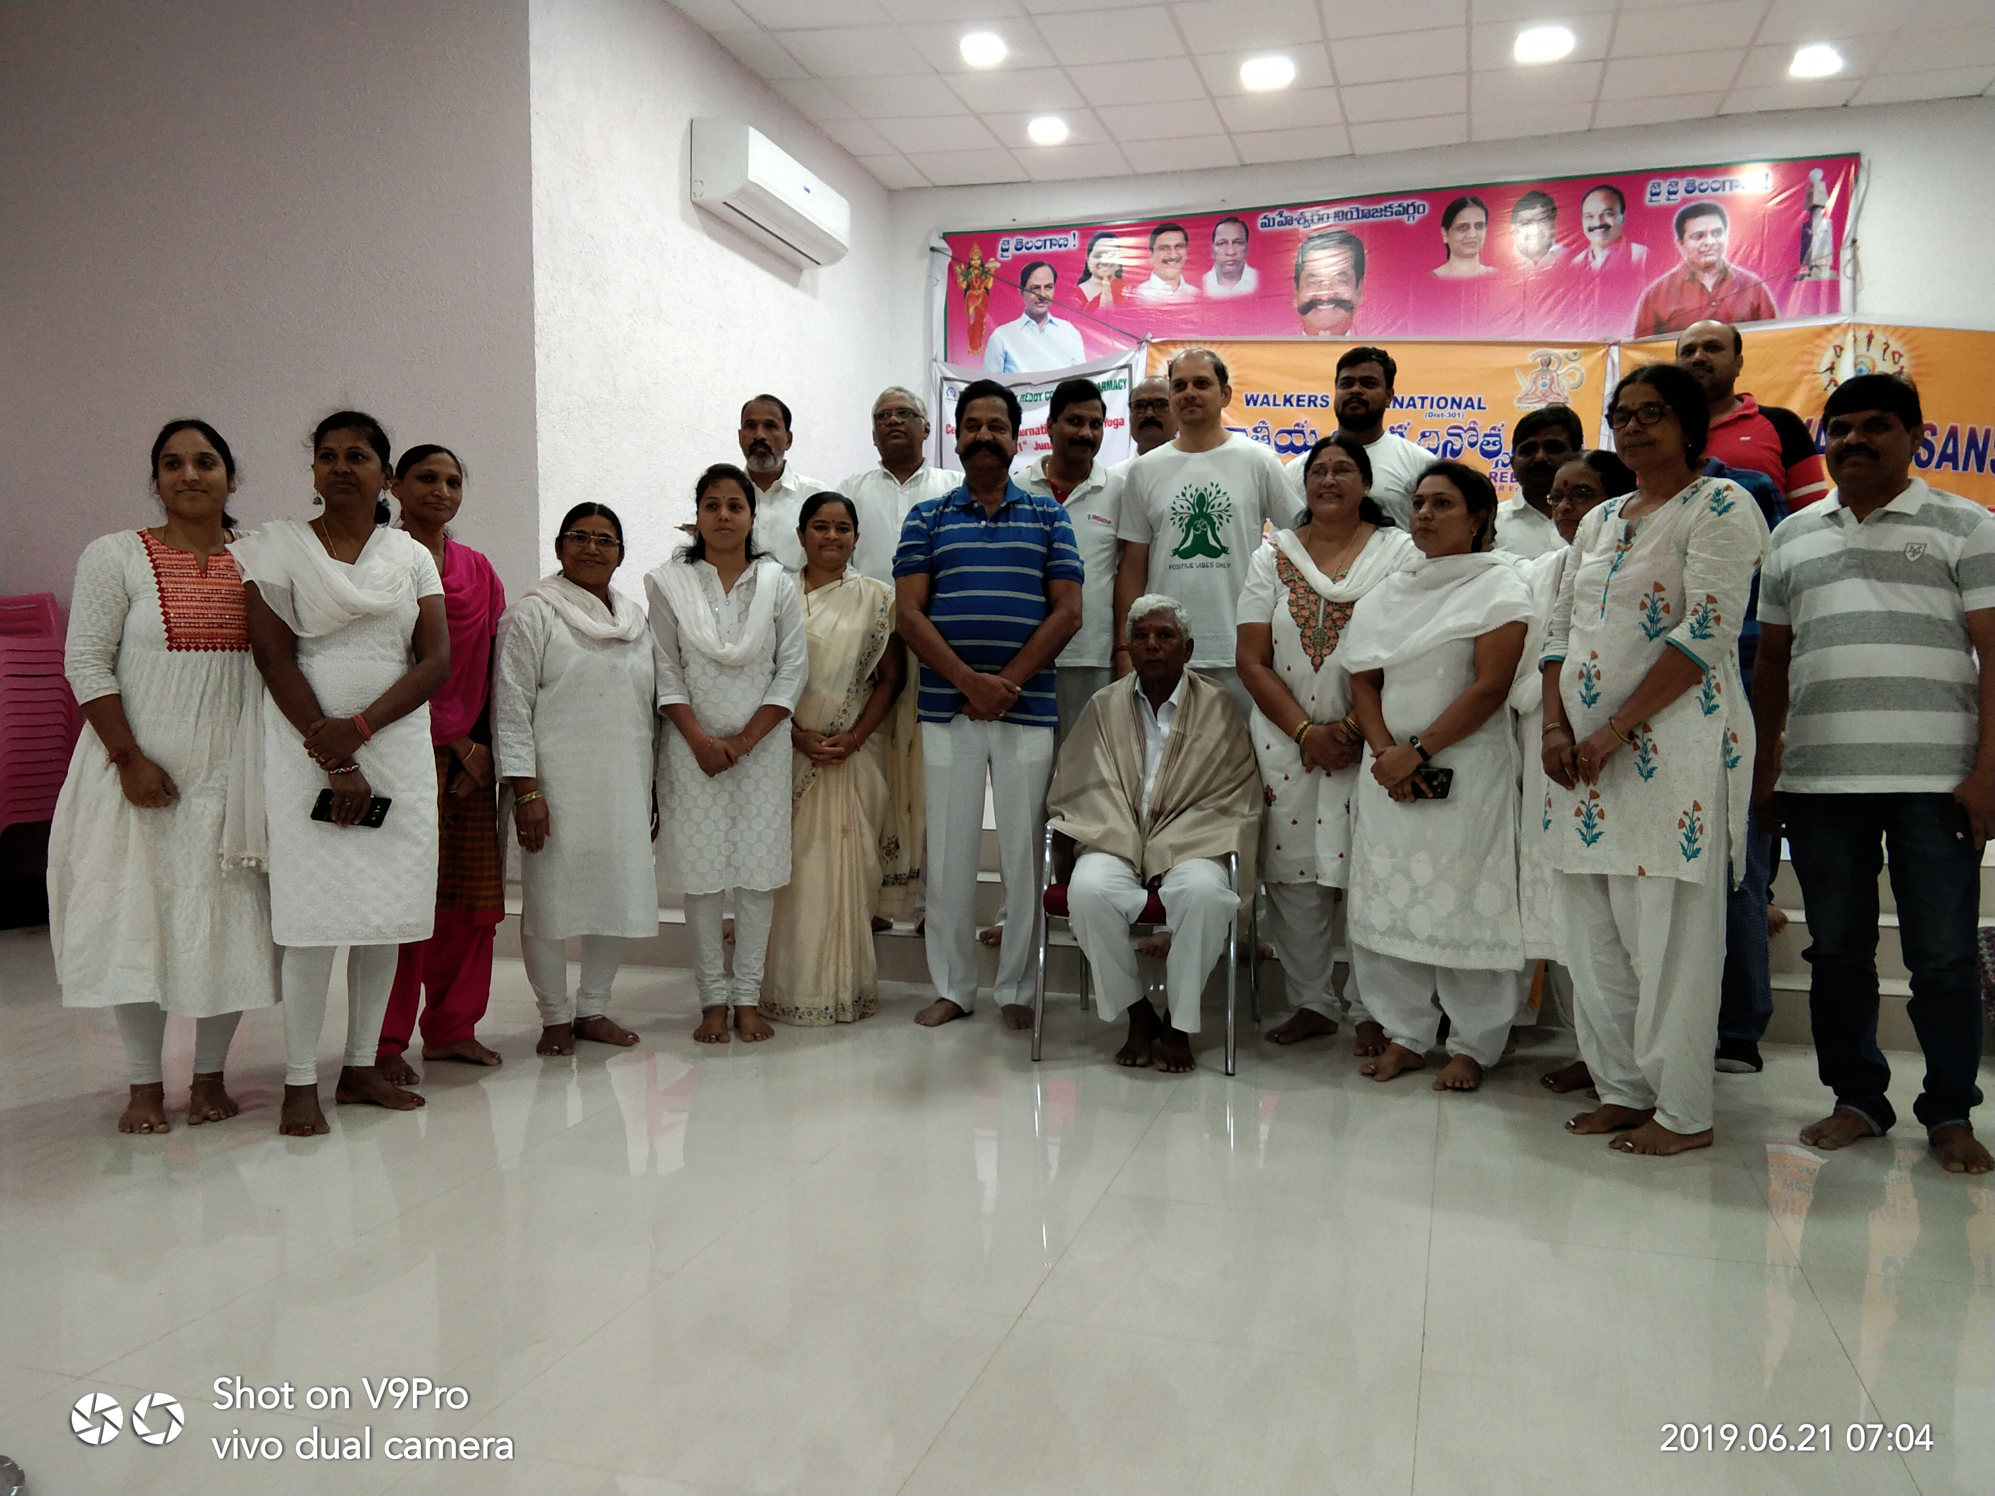
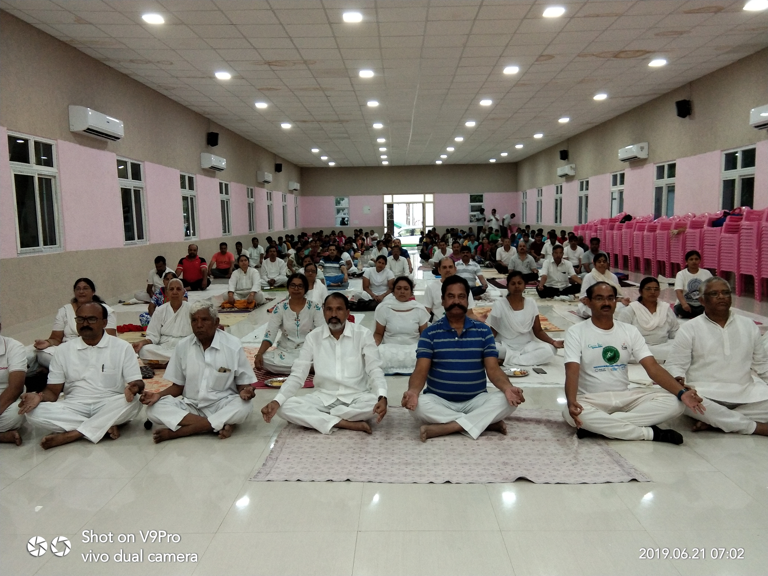
YOGA DAY

Slide 35
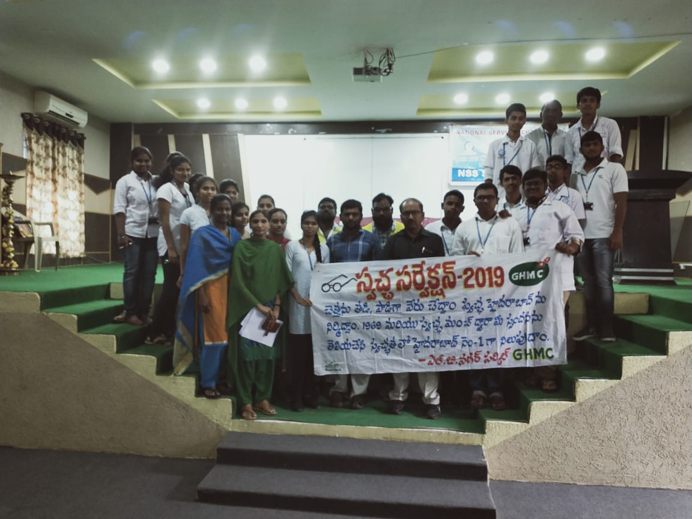
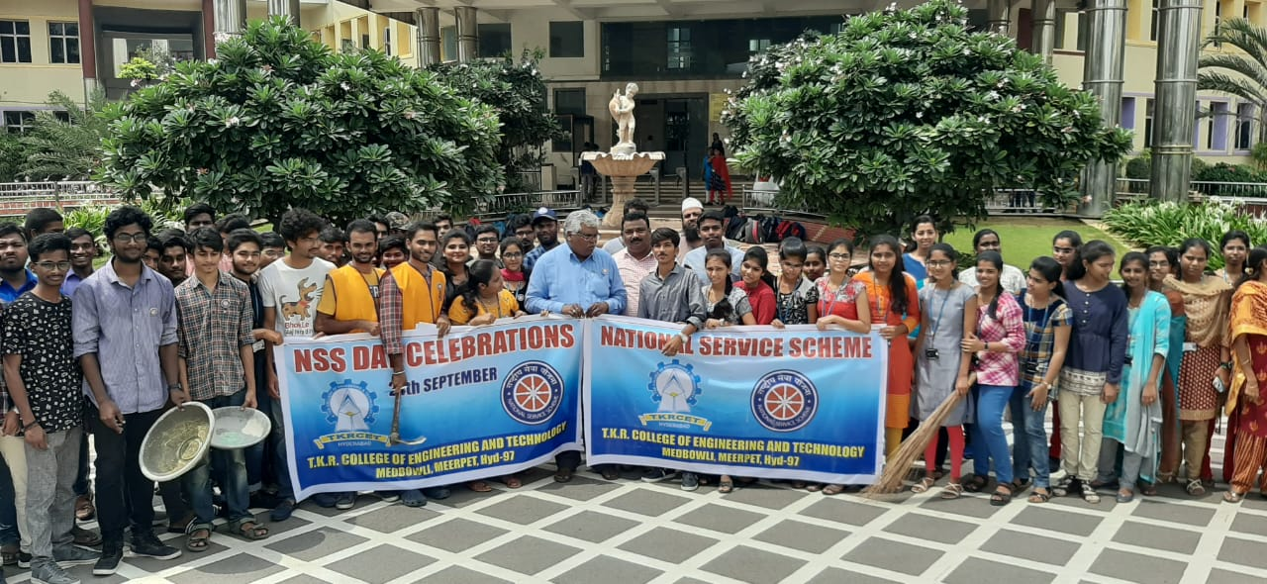
swach sarvekshan clean and green program

Slide 36
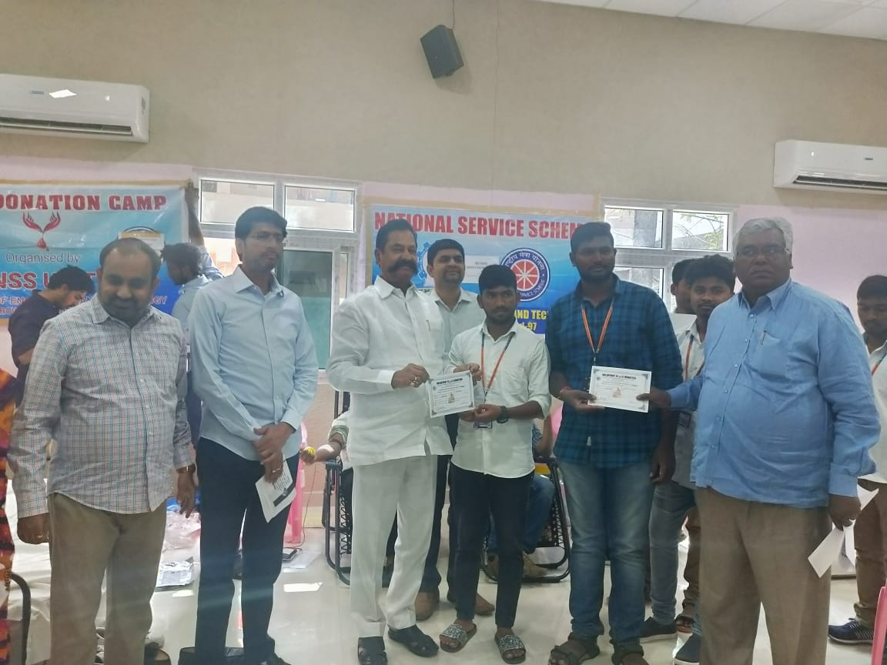
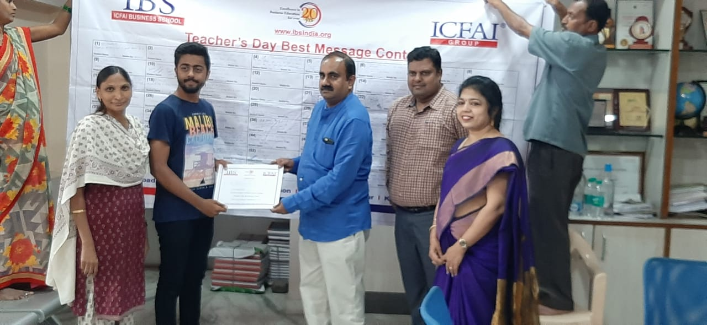
blood donation camp teachers dayamp

Slide 37
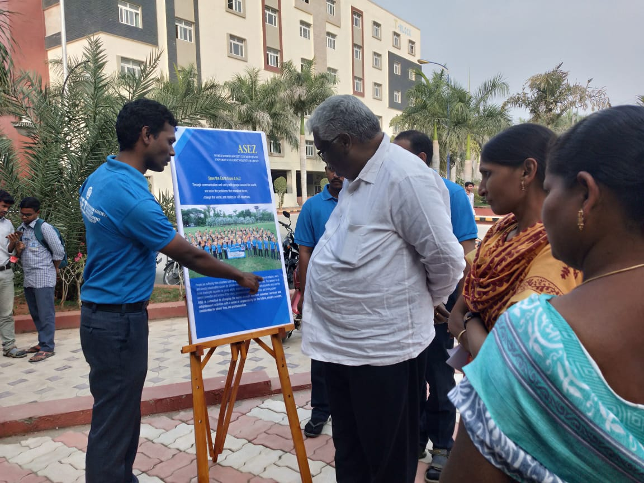
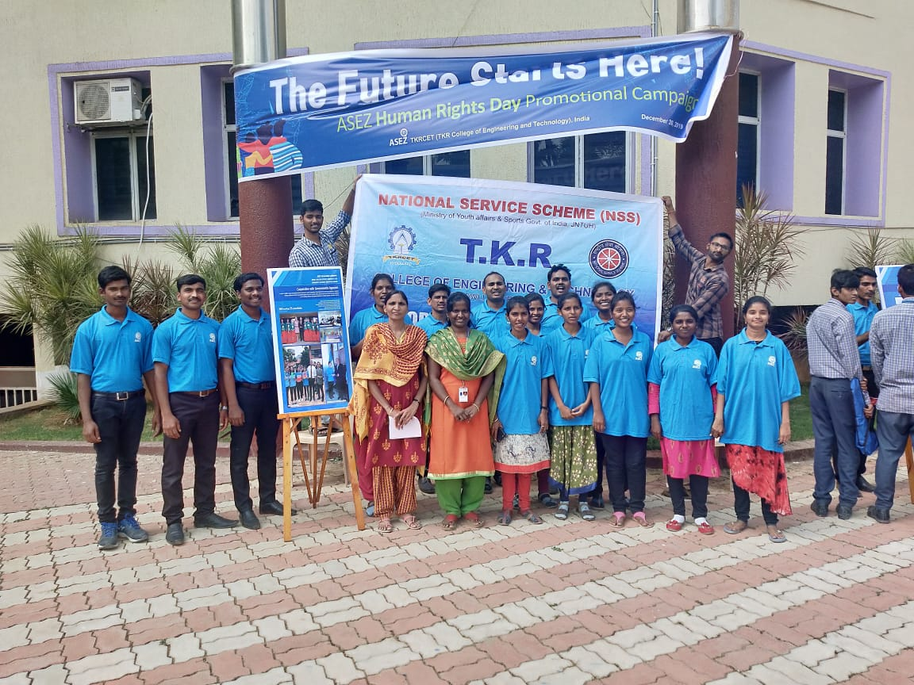
Awareness programm on Girl safety

Slide 38
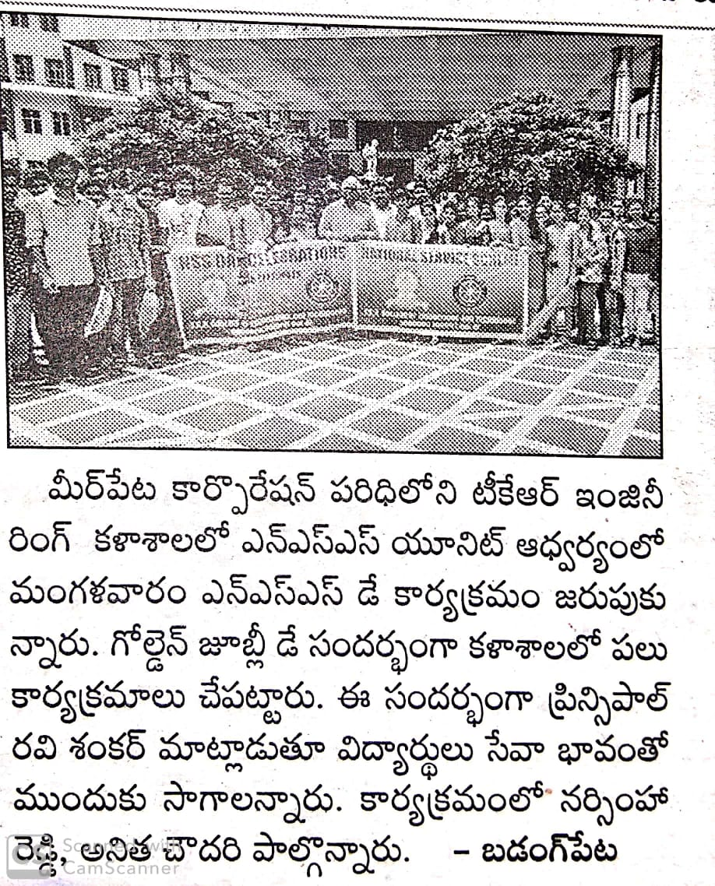
NSS DAY DAY

Slide 39
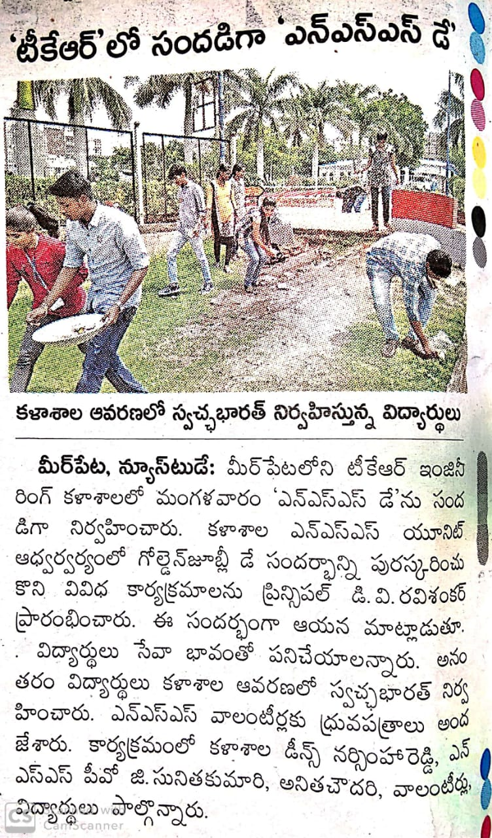
NSS DAY

Slide 40
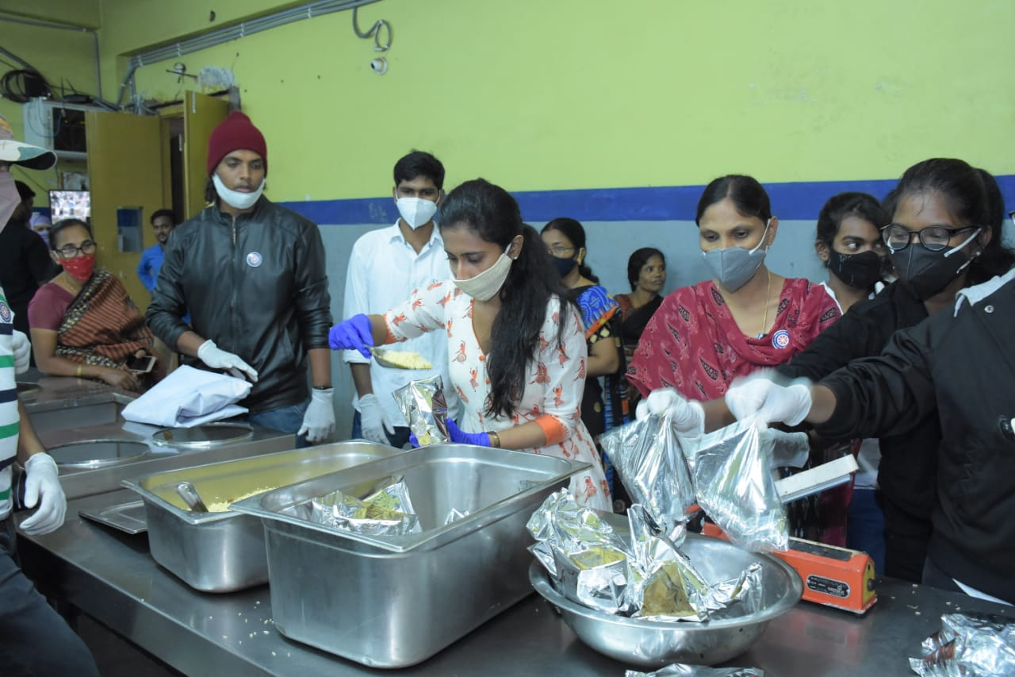
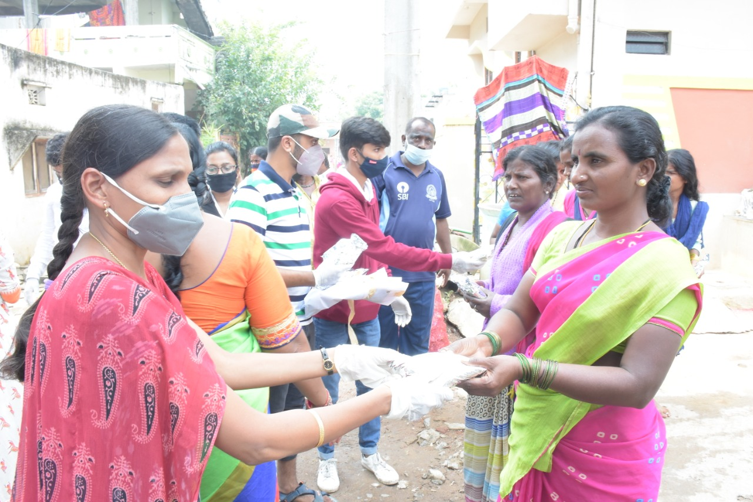
FOOD DISTRIBUTION

Slide 41
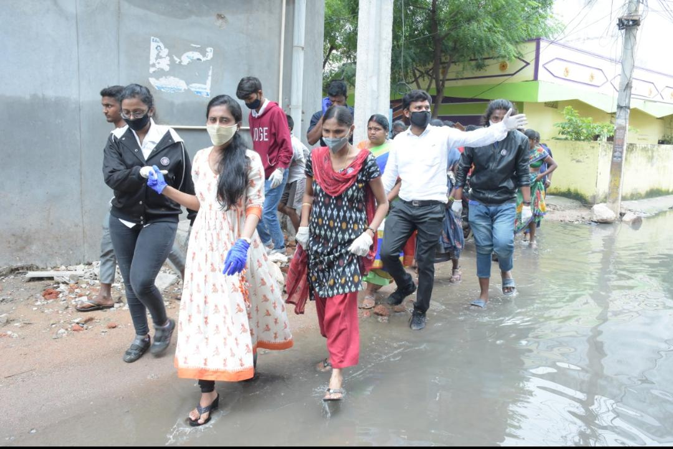
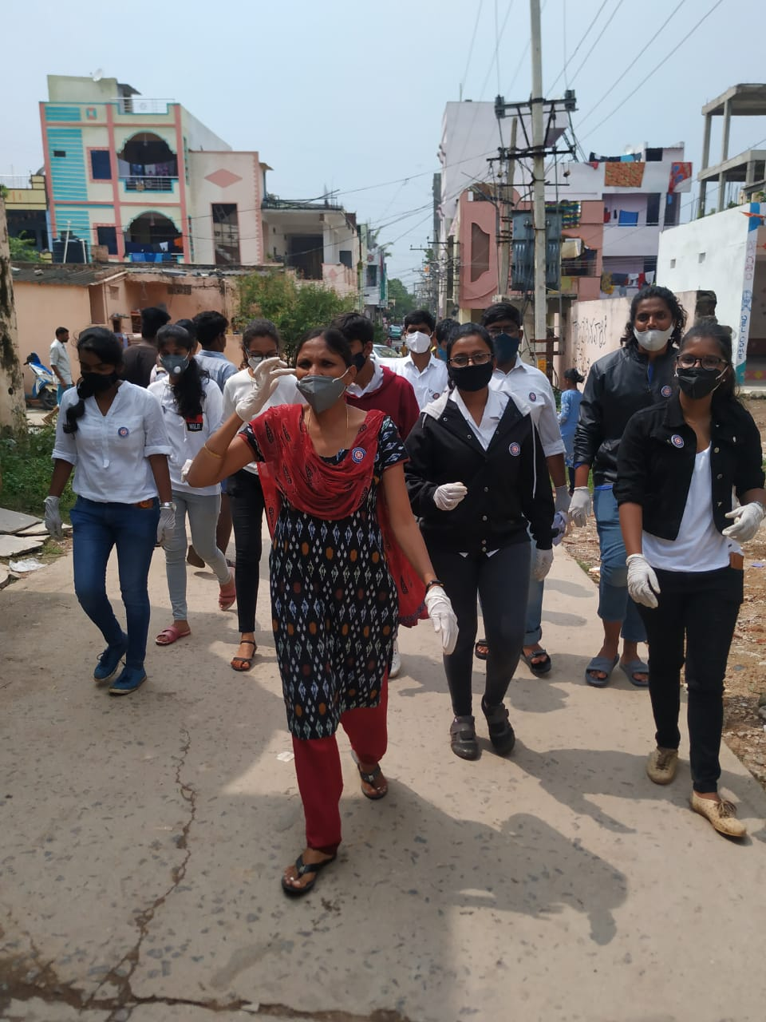
FLOOD AFFECTED AREAS

Slide 42
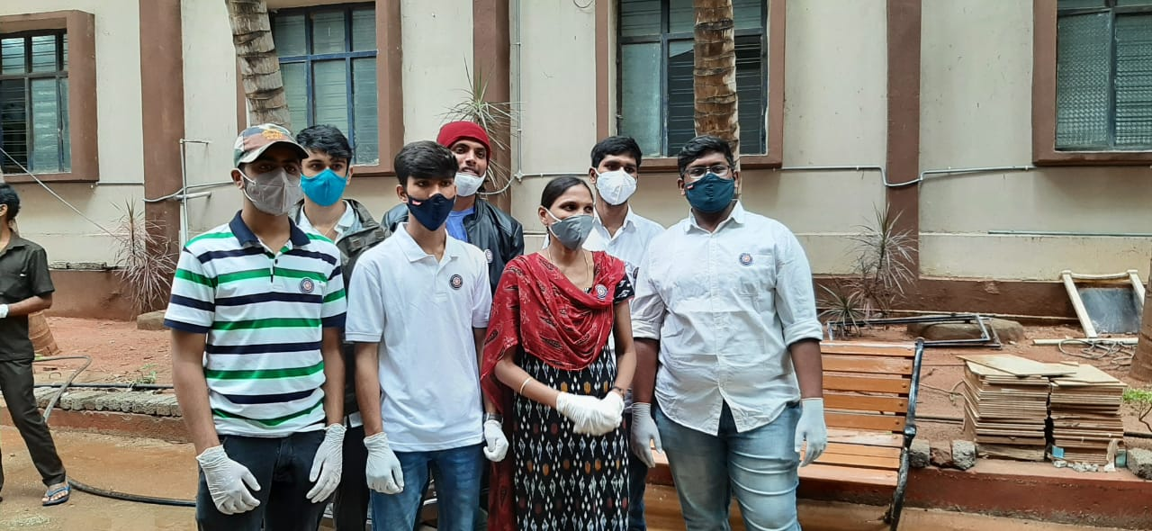
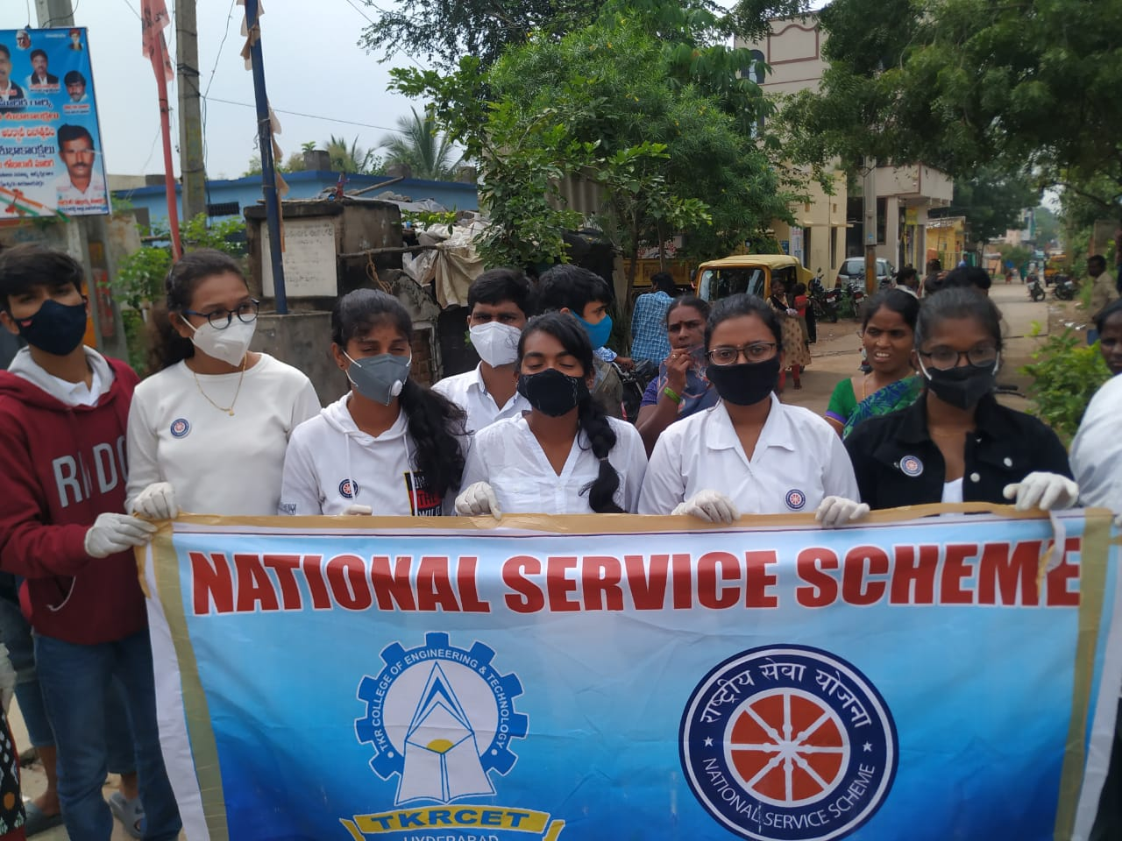
NSS TEAM - EVER READY TO HELP

Slide 43
YOGA DAY

Slide 44
Thank you for your
kind Attention

