Slide 1
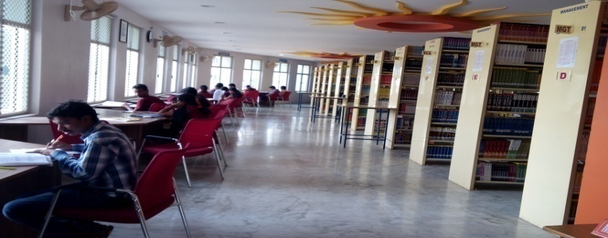
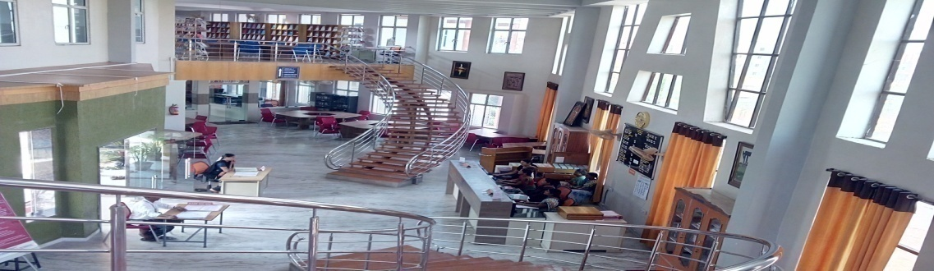
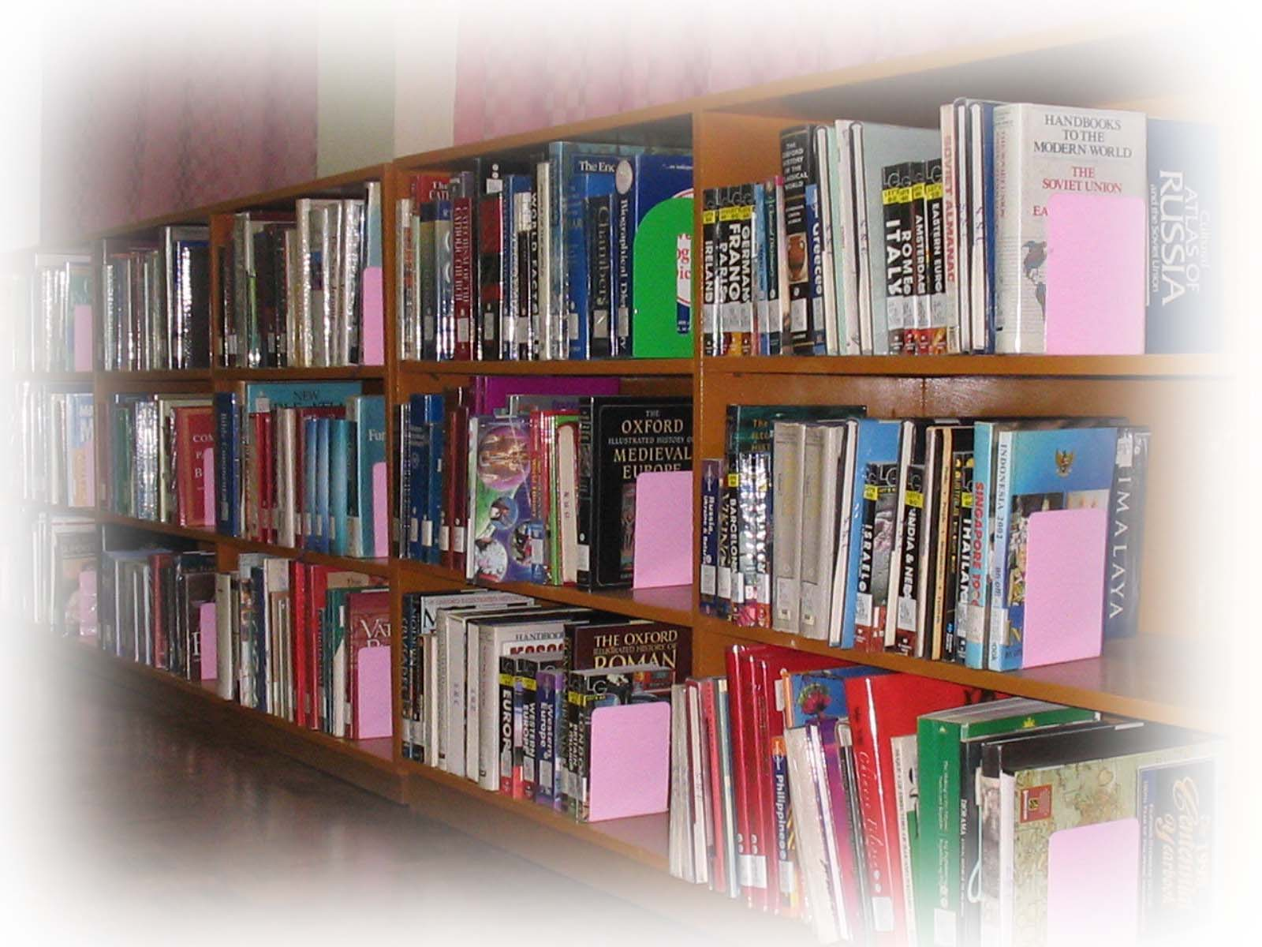
Central Library
TKR College of Engg & Technology
Welcome to Fresher's
2020 - 2021
by:
G.Srinivas Reddy
Chief Librarian

Slide 2
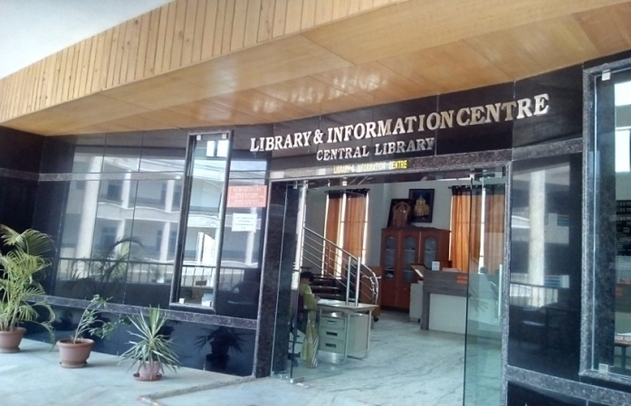
LIBRARY ORIENTATION
User Awareness Program 2020-21

Slide 3
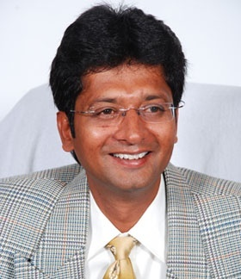
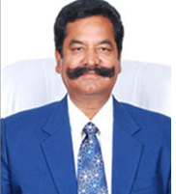
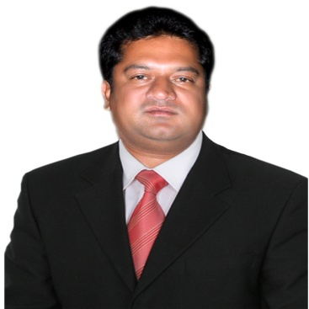
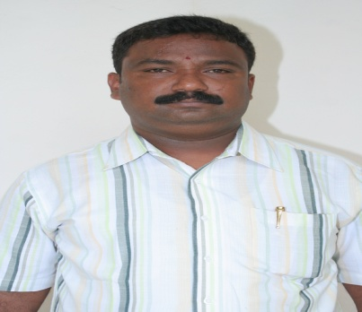
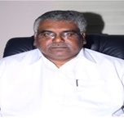
Central Library
TKR EDUCATIONAL SOCIETY
Dr.T.Harinath Reddy
Secretary
SRI TEEGALA KRISHNA REDDY
Chairman
Mr.T.Amarnath Reddy
Treasurer
G.L.N.Reddy
Administrative Officer
Dr.D.V.Ravi Shankar
Principal

Slide 4







Central Library
TKR COLLEGE OF ENGINEERING & TECHNOLOGY
(An Autonomous Institution)
Accredited by NBA & NAAC with ‘A’ Grade
Approved by AICTE- New Delhi
Affiliated to JNTU – Hyderabad

Slide 5
Central Library
INSTITUTIONS ESTABLISHED BY THE SOCIETY
TKR College of Engineering & Technology - 2002
TKR Institute of Management & Science - 2003
Teegala Krishna Reddy Engineering College - 2005
Teegala Krishna Reddy College of Pharmacy- 2007
TKR College of Engineering & Technology - 2009
(2nd Shift Polytechnic)
Teegala Krishna Reddy Engineering College - 2009
(2nd Shift Polytechnic)

Slide 6
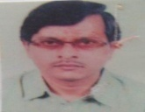
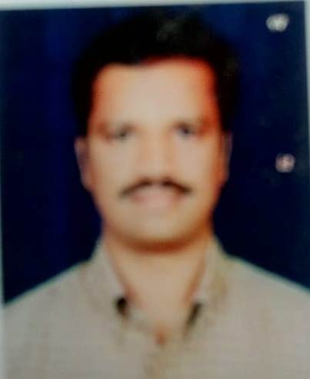
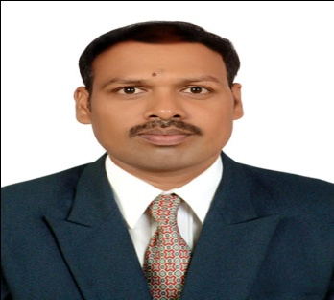
Central Library
Head of the Departments
CIVIL - Prof.K.V.R.Satya Sai
Experience – 15 Years
Contact No. 9885622969
MECH - Dr.G.Gopala Krishna
Experience – 16 Years
Contact No.9490322346
EEE - Dr.S.Narasimha
Experience – 12 Years
Contact No.9885191661

Slide 7
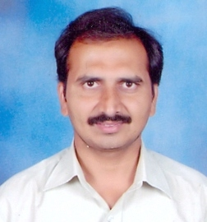
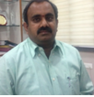
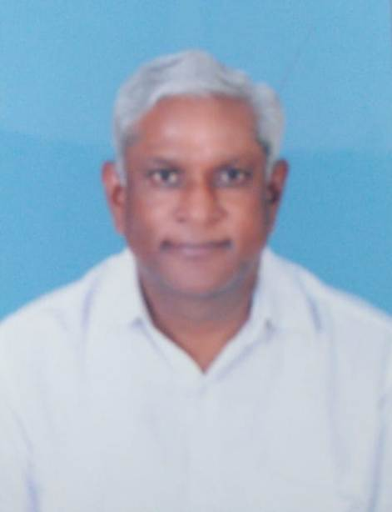
Central Library
Head of the Departments
ECE - Dr.D.Nageswara Rao
Experience – 18 Years
Contact No. 9866807254
CSE - Dr.A.Suresh Rao
CSE(AI & ML) Vice-Principal
CSE(DS) Dean Academics
Experience – 19 Years
Contact No. 9866490867
IT - Dr.N.Satyanarayana
Experience – 32 Years
Contact No. 7569107473

Slide 8
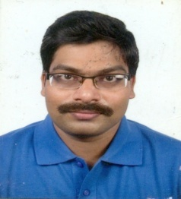
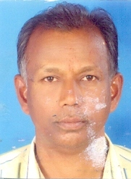
Central Library
S&H Departments
Physical Science - Dr.B.Rajinikanth
Experience – 17 Years
Contact No. 8498085223
Physical Science - Dr.B.Narasimha
Experience – 32 Years
Contact No. 9490356088

Slide 9
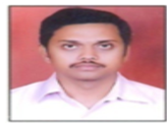
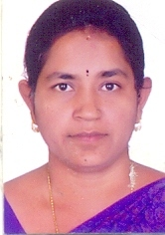
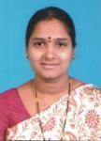
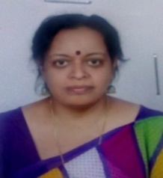
Central Library
Mathematics - Dr. D.R.V.S Anil Kumar
Experience – 19 Years
Contact No. 9490189395
Mathematics - Dr.C.Uma Devi
Experience – 17 Years
Contact No. 9848289961
Mathematics - Dr.D.Pramadha
Experience – 16 Years
Contact No. 9440177080
English - Dr.M.Sudha Menon
Experience – 20 Years
Contact No. 8340895993

Slide 10
Central Library
Students Strength:
B.Tech
Branch Intake
Civil 120
EEE 120
Mech 120
ECE 240
CSE 240
CSE(AI & ML) 60 CSE(DS) 60
IT 60
-------------------------------------------------------------------------------------
Total 1020
-------

Slide 11
Central Library
Orientation
Central Library conducts user orientation / user Awareness programme every year for the fresher’s ( Ist year students of B.Tech) at the beginning of the Academic year.
Newly admitted students of B.Tech course year 2020-21 (19th Batch).

Slide 12
Central Library
AIMs of Orientation
To ensure that Library users can make use of Library resources and services adequately to their own satisfaction.
Library orientation makes library users aware of the Library and the services.
It educates the users regarding general use of the library.

Slide 13
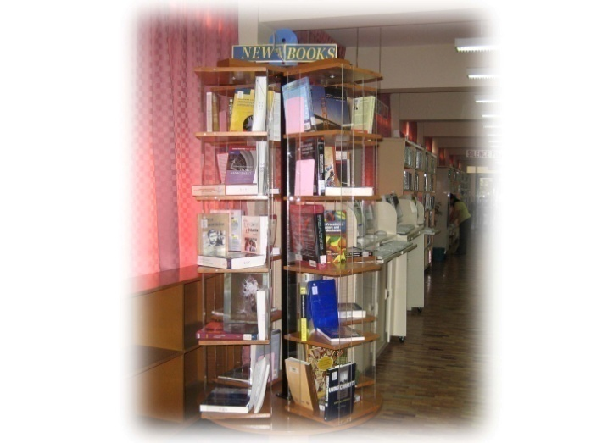
Central Library
Objectives :
• To acquire, organize and update the library collection to support the College Unit’s Teaching-Learning program.
• To encourage students to read beyond the requirements of the curriculum.

Slide 14
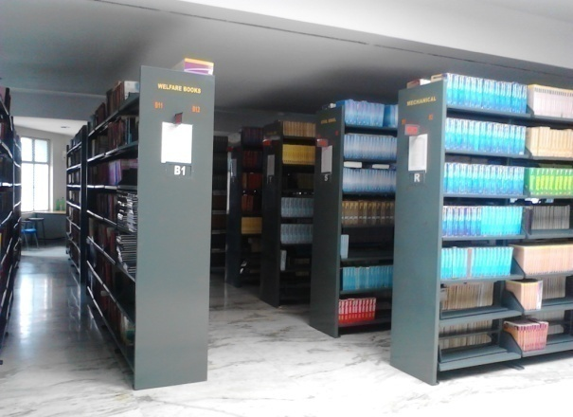
Central Library
Location:
The Library Building is located on the second floor of the Central block with Duplex. There are four Levels.
Wing -A
Wing - C
Entrance
Circulation
Digital Library
Reading Hall-1
Periodicals
Career Books
Competitive Books
Reading Hall-3
Wing -B
Wing - D
Library Office
U.G. Stock
P.G. Stock
Reading Hall - 2
Reference Section
Text Books
Welfare Books
Reading Hall - 4

Slide 15
Central Library
What is Library
Library is a collection of Books
A place set a part to contain Books, Periodicals, Digital formats and other materials.
Library is an Information Centre
Library is a Resource Centre
Library is a Documentation Centre
Library is a Knowledge Hub
Library is a heart of the Institution
.

Slide 16
Central Library
Library collection can includes
Books
Periodicals
Non-book Material
Manuscripts
Audio Visual Items
Online Databases
Back Volumes
Projects / Dissertations
Archives etc.,

Slide 17
Central Library
About the Central Library
The Central Library was initially setup in August-2002 in 2nd floor south block, it moved to the central block in 2013.
The library is spread over 2 floors, second and third with duplex model with total carpet area 1510 sqr.metrs.4 sections with the capacity of 300 seats.
The Library uses the DDC classification scheme and books are arranged is Branch wise and subject wise in alphabetical order.
All in-house operations in the Library are fully computerized (Automation) using the NEWGEN LIB Library Management software

Slide 18
Central Library
When is the Library Open?
REGULAR/SEMESTER
9:00 a.m. – 6:00 p.m. Mon – Sat
10:00 a.m. – 1:00 p.m. Sunday
DURING SUMMER
VACATION
9:30 a.m. – 05:00 p.m. Mon – Sat
CIRCULATION
9:00 a.m. – 5:00 p.m. Mon – Sat
(

Slide 19

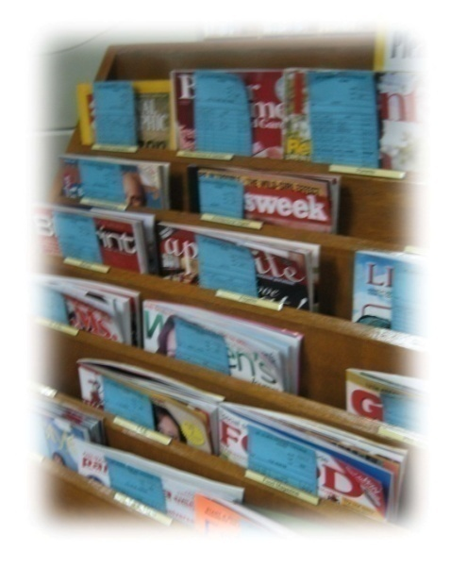
Central Library
Library Resources:
  Total Volumes (Books): 85,946
  Total Titles : 8,790
National Journals : 155
IEEE Journals : 230
Technical Magazines : 42
Newspapers : 12
Back Volumes : 5,140
Projects / Dissertations : 2,722

Slide 20
Central Library
Branch wise Collection
BRANCH | TITLES | VOLUMES
CIVIL | 222 | 3,503
EEE | 645 | 6,750
MECH | 683 | 7,899
ECE | 876 | 9,964
CSE | 842 | 7,855
IT | 334 | 3,451
BT | 664 | 4,140
S&H | 778 | 16,840

Slide 21
Central Library
TEXT BOOK
A Text Book is a book used for the study of a subject People use a text book to learn facts and methods about a certain subject.
Text Books some times contain Questions to test the knowledge and understanding of the learner.
Types of usage of text books
Class wise
Year wise
Subject wise
Course wise, Part wise

Slide 22
Central Library
REFERENCE BOOK
Reference works are usually referred to for particular pieces of information, rather than for reading from beginning to end.
Types of Reference Books
Atlas – Collection of maps
Biography – Lives of prominent and noteworthy people
Dictionary – Definitions, spellings, uses
Directory – Addresses and locations or people or organizations
Encyclopedia – often multi-volume sets, broad over views or Topics
Hand Book – “Handy” Information on a particular subject
Manual – How to instructional guides
Year Book – Published annually to update information of previous year

Slide 23
Central Library
Journal
A Journal is a scholarly publication containing articles written by researchers, professors and other experts.
A Journal focuses on a specific Subject/ discipline or any field of study.
College subscribed all the Subject Journals for every year.
National, International and Online

Slide 24
Central Library
Periodical Publications
Subscribed Journals-2020
National Jr. - 155
Journals
International Jr. - 219
Online Jr. – 3,335
Technical - 16
Magazines
General - 26
Telugu - 06
Newspapers
English - 06

Slide 25
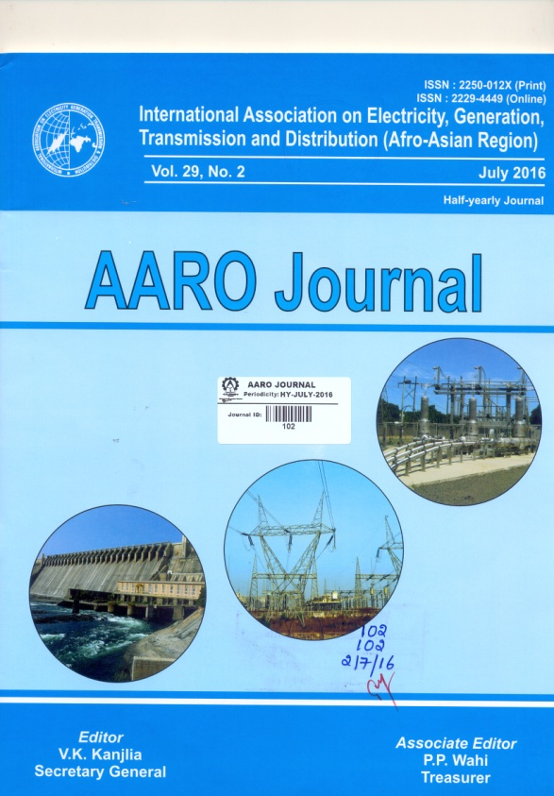
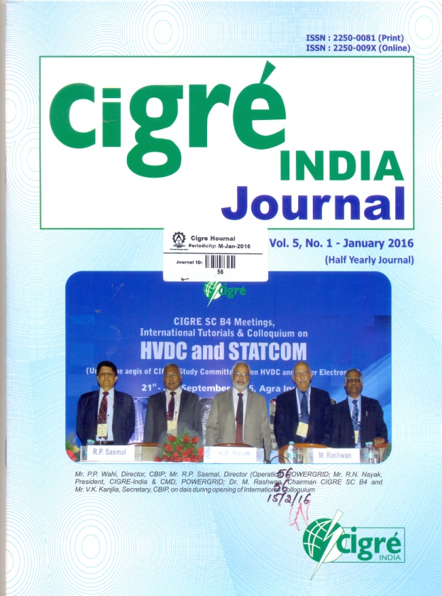
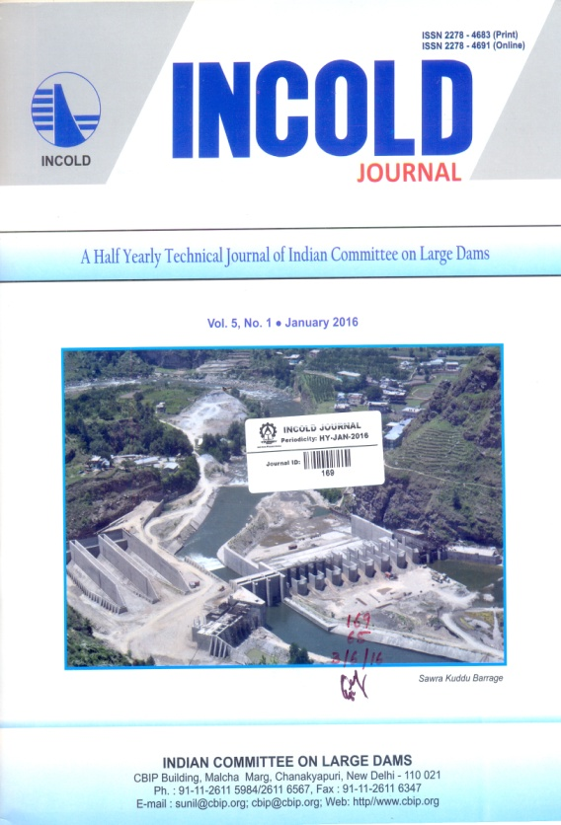
NAT IONAL
JOURNALS
2020
Central Library
Print Journals

Slide 26
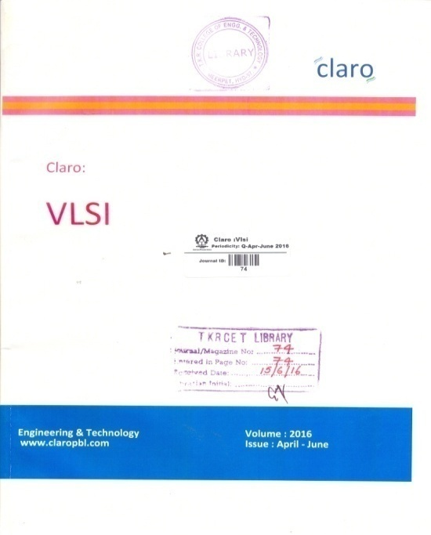
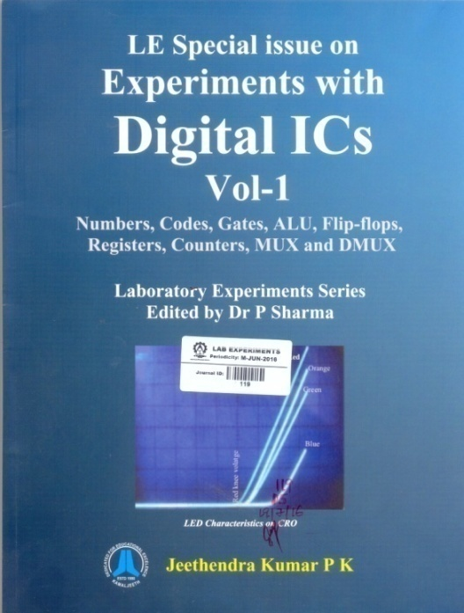
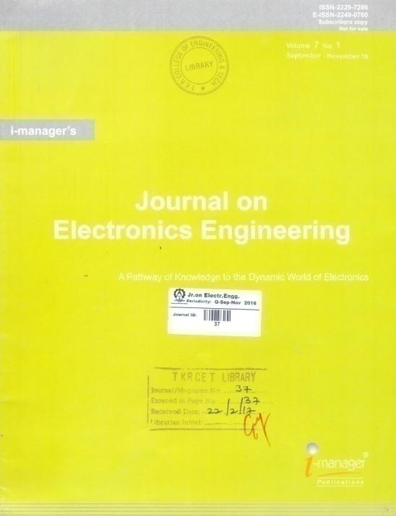
NAT IONAL
JOURNALS
2020
Central Library

Slide 27
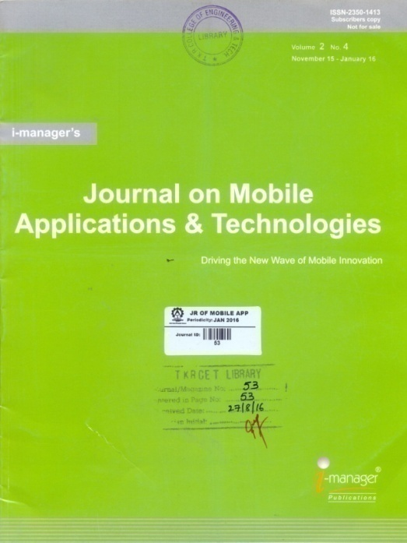
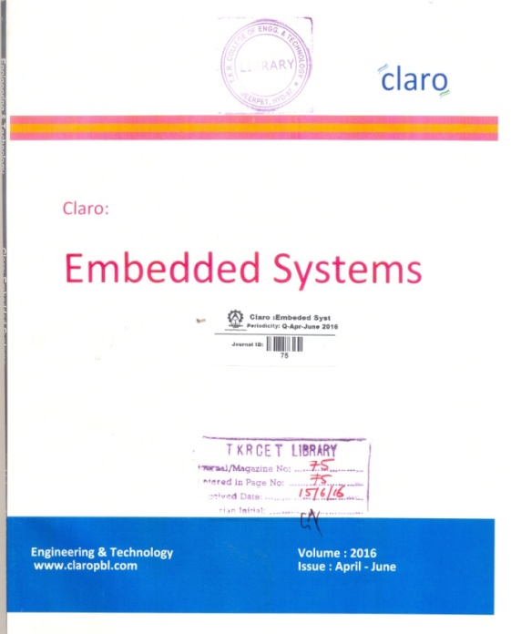
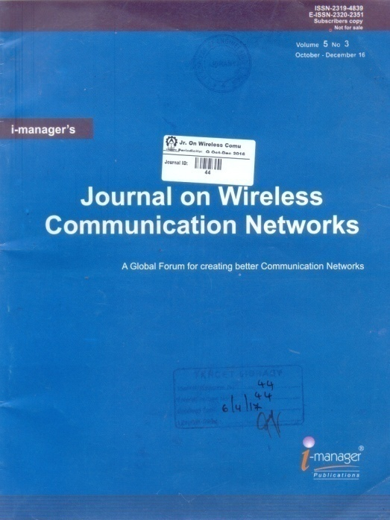
NAT IONAL
JOURNALS
2020
Central Library

Slide 28
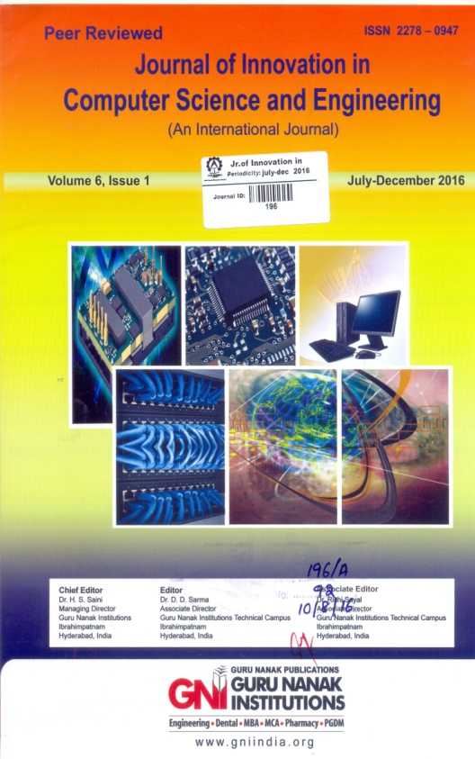
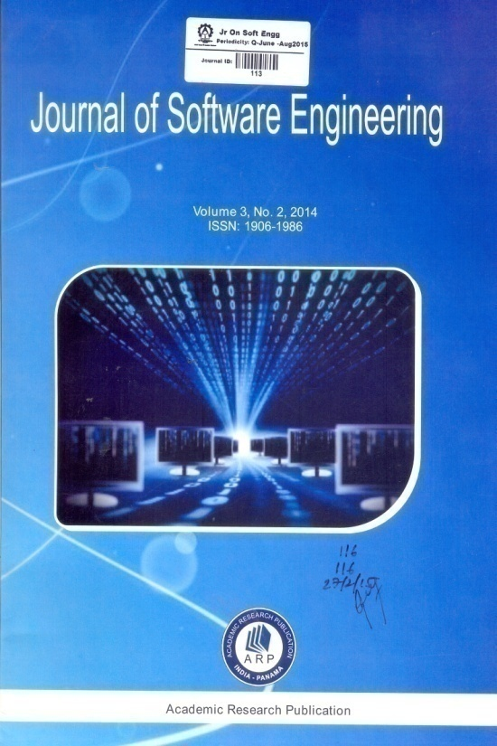
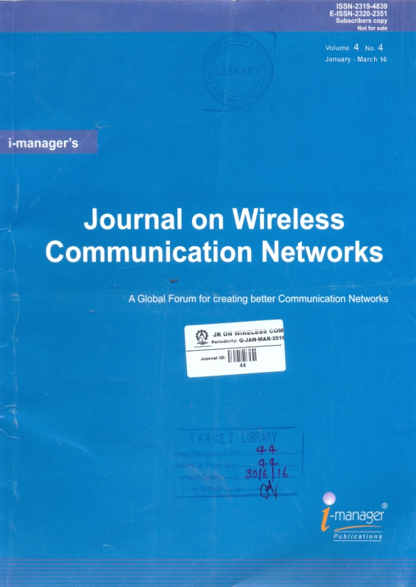
NAT IONAL
JOURNALS
2020
Central Library

Slide 29
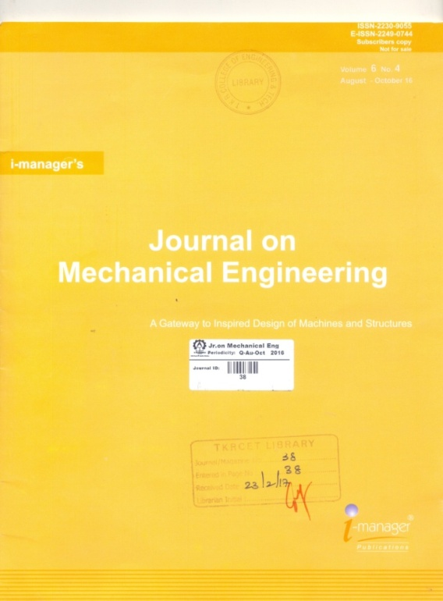
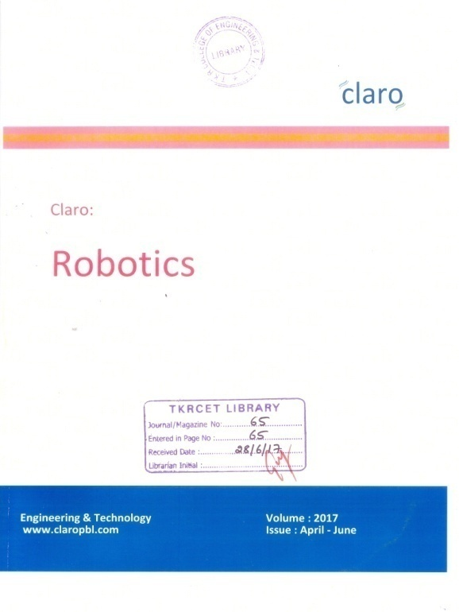
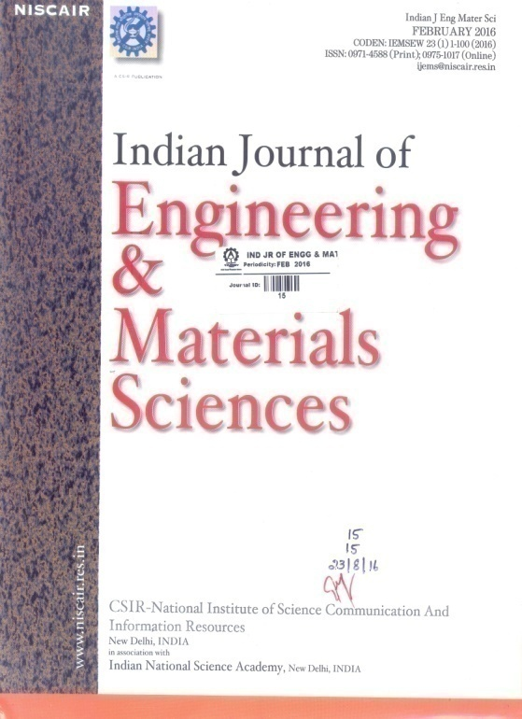
NAT IONAL
JOURNALS
2020
Central Library

Slide 30
Central Library
Magazines
Technical and Competitive
S.No | Name of the Magazine | S.No | Name of the Magazine
1 | Out Look | 11 | India Today
2 | The Week | 12 | Competition Refresher
3 | Sports Star | 13 | Current Affairs
4 | Junior Science Refresher | 14 | Mathematics Today
5 | Employment News | 15 | Chemistry Today
6 | Linux for you | 16 | Physics For you
7 | Business India | 17 | Biology Today
8 | Business World | 18 | Career Chronicle
9 | Front Line | 19 | Engineering Success Review
10 | Readers Digest | 20 | Telugu Vidhyardhi
(…Contd…)

Slide 31
Central Library
S.No | Name of the Magazine | S.No | Name of the Magazine
21 | Digit | 31 | Business for all
22 | Mahendra's in Current Affairs | 32 | Pratiyogita Darpan
23 | Udyogasopanam | 33 | Pratiyogita Kiran
24 | Careers 360 | 34 | Shine India
25 | Out Look Business | 35 | Out Look Turning Points
26 | Electronics for you | 36 | Business Today
27 | Civil’s Chronicle | 37 | Science Refesher
28 | Science Repoter | 38 | IETE Newsletter
29 | Out Look Money | 39 | Sandeepani
30 | The IT COM Week | 40 | Corporate Citizen

Slide 32
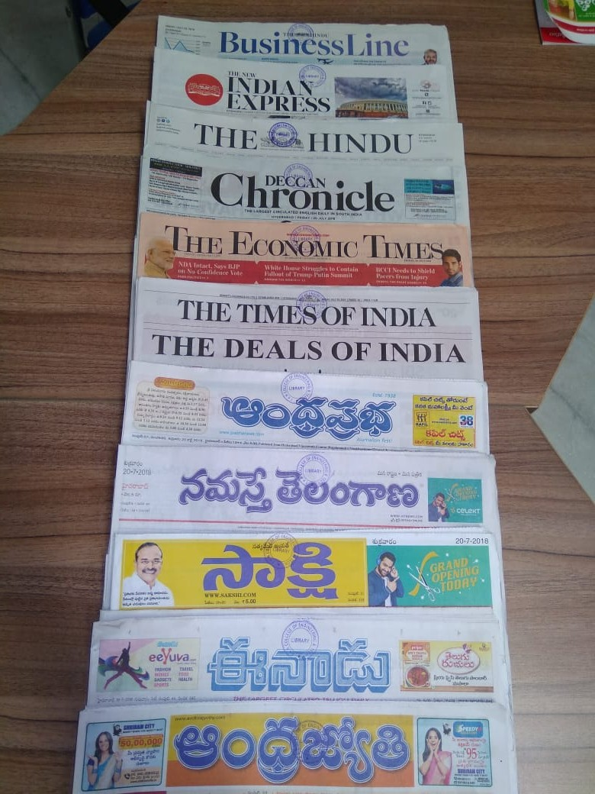
Central Library
Newspapers
Telugu & English

Slide 33
Central Library
News Papers( Information Related to Education)
S.No | Newspaper | Special Edition / Editorial Item | Day
1 | The Hindu | Education Plus, Opportunities, Science & Technology | Mon, Wed & Thu
2 | Times of India | Education Times, Ascent | Mon, Wed
3 | Indian Express | The Indian Express Edex, Job opportunities, Magazine | Mon, Wed, Sun
4 | Deccan Chronicle | Career Chronicle | Tue, Thu, Sat
5 | Business Line | E World the New Manager, Life Opinion, Taxation | Mon, Fri, Sat
6 | The Economic Times | ET Investors Guide/ ET Wealth, Technolik | Mon, Tue
(…Contd…)

Slide 34
Central Library
S.No | Newspaper | Special Edition / Editorial Item | Day
7 | Eenaadu | Education, Employment, Sukhibhava, Sports, e-Naadu/ E-Learning, Career Chronicle, E-Learny, Magazine | Mon, Tue, Wed, Thu ,Fri, Sat, Sun
8 | Andhra Jyothi | Dhiksuchi, Doctor, Technology, Tourism, Nivedana, Job Corner, Young | Mon, Tue, Wed, Thu, Fri, Sat, Sun
9 | Andhra Prabha | Vidya Prabha, Khulasa, Nayeeka, Sarigamalu, Chintana, Magazine | Mon, Tue, Wed, Thu, Fri, Sat Sun
10 | Namasthe Telangana | Jeevana Rekha, Notifications, Nipuna | Mon, Tue, Wed, Thu, Fri, Sat, Sun

Slide 35
Central Library
Competitive Books
1 | GRE | 6 | A Modern Approach to Verbal Reasoning
2 | TOFEL | 7 | A Modern Approach to Logical reasoning
3 | GMAT | 8 | Arithmetic / Logical Sequence
4 | CAT | 9 | English Learning Skills / Grammar
5 | IELTS | 10 | A Course in English Grammar

Slide 36
Central Library
11 | Communication Skills | 16 | Written Commu. in English
12 | Boost your Interview IQ | 17 | Strength your Writing
13 | Competitive Competence | 18 | Numerical Analysis
14 | Teaching of science | 19 | Non-Verbal Reasoning
15 | The Confidence Plan | 20 | 1000 Writing Remedies

Slide 37
Central Library
Library Registration / Membership
How to become a member of the Library?
All the Students after getting their college enrollment number / id card may collect the requisite . Membership form available at the library counter and submit the same duly filled along with
Passport size colour photos - 1
Stamp size colour Photos - 3
Academic fee challan (Library copy) - 1

Slide 38
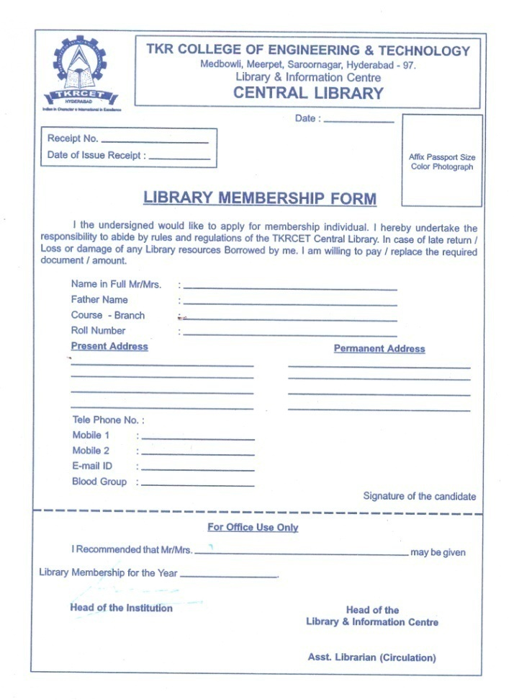
Central Library
Membership Form

Slide 39
Central Library
Borrowing Privilege
Category of Member | No.of Books Issued | Duration of Issue
B.Tech, M.Tech and MBA students | 3 | 15 Days
Polytechnic students | 4 | 15 Days
Academic Merit Card(Class Topper) | 2 | 15 Days
Other staff of the Group | 2 | 15 Days
Faculty, Teaching UG, PG and Research | 5 | One semester
Non-Teaching staff, Academics and Administration | 3 | One semester
Technical and Supporting staff | 2 | One semester

Slide 40
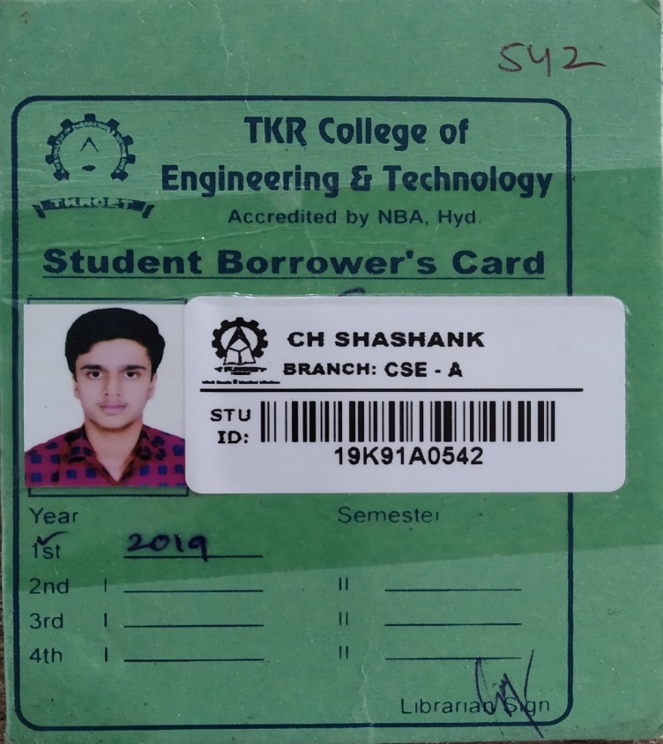
Central Library
Borrower’s Card
Library Card
(Each student issued 3 cards)

Slide 41
Central Library
Duplicate Library Card
Incase you lose your Library membership card a duplicate card can be obtained on payment of Rs.100/-
Please do not lend your library card as you will be held responsible for any loss of books or missing pages issued against your card.

Slide 42
Central Library
Book Bank
The Book Bank Scheme is available for every semester( Ist Year to IVth Year)
A set of Books are issued for a semester wise.
For any other details to contact
Book Bank Incharge – B.Radhika - 9542496395
– M.Parijatha - 9705211340

Slide 43
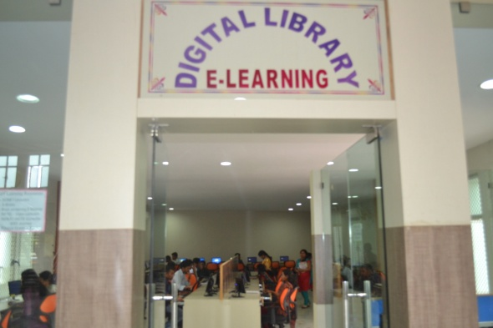
Central Library
Digital Library / Virtual Library
The Digital Library was established with 50 systems and high speed Internet Band width, Wi-Fi enabled.

Slide 44
Central Library
Automation
The Central Library functions are automated using an integrated “NEWGENLIB” Library management Software.
Books Acquisition
Circulation
Classification
Cataloguing
Periodical Subscription
OPAC
Admissions

Slide 45
Central Library
OPAC :
(Online Public Access Catalogue)
OPAC catalogue one can search the Library Database ( Stock) to know the status of the Library Books.
OPAC search by entering any one of the following field
Title / Author / Subject/ Class Number /
Accession Number / Publisher

Slide 46





Central Library
e-Learning Databases
NPTEL www.nptel.ac.in
NDL www.ndl.iitkgp.ac.in
SWAYAM www.swayam.gov.in
SWAYAM PRABHA www.swayamprabha.gov.in
N-List www.nlist.inflibnet.ac.in

Slide 47
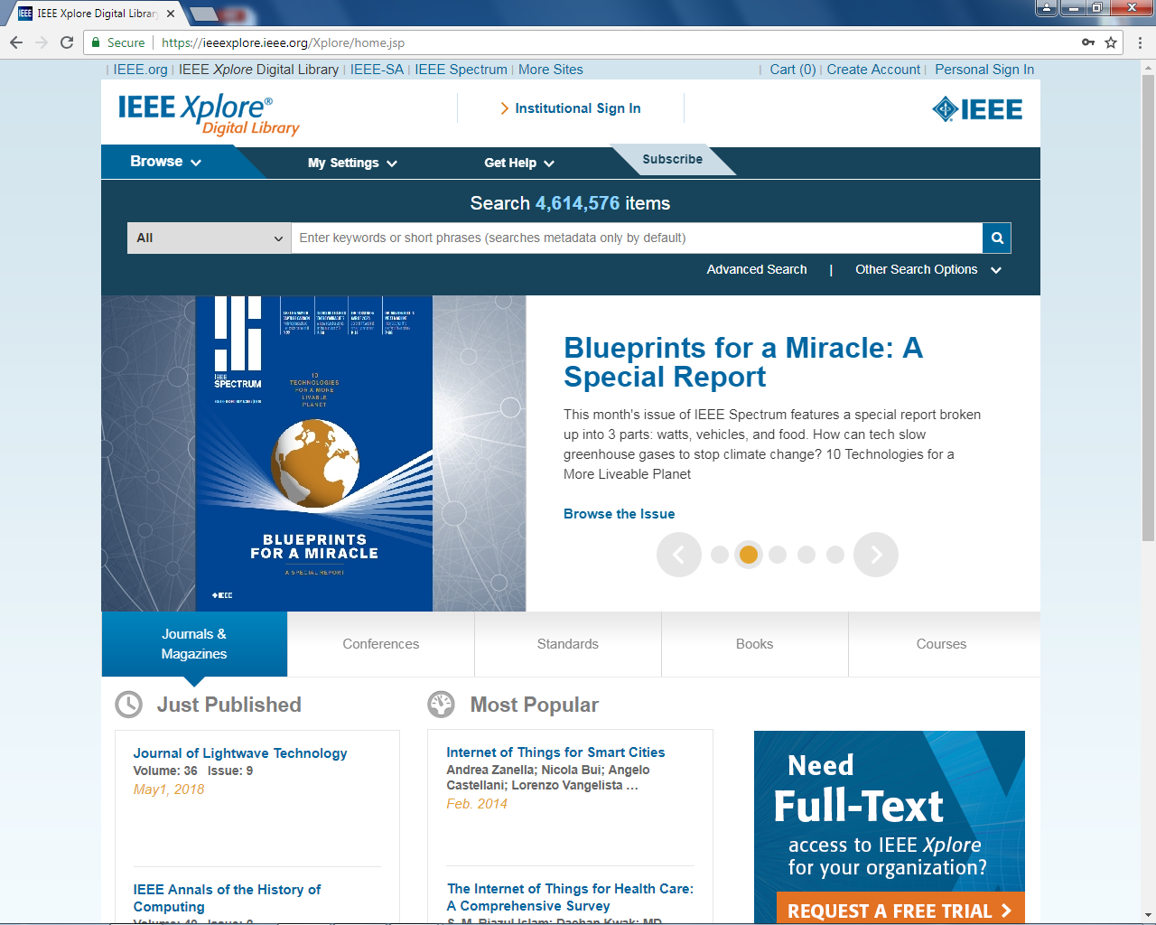
Central Library
IEEE – DIGITAL XPLORE JOURNALS

Slide 48
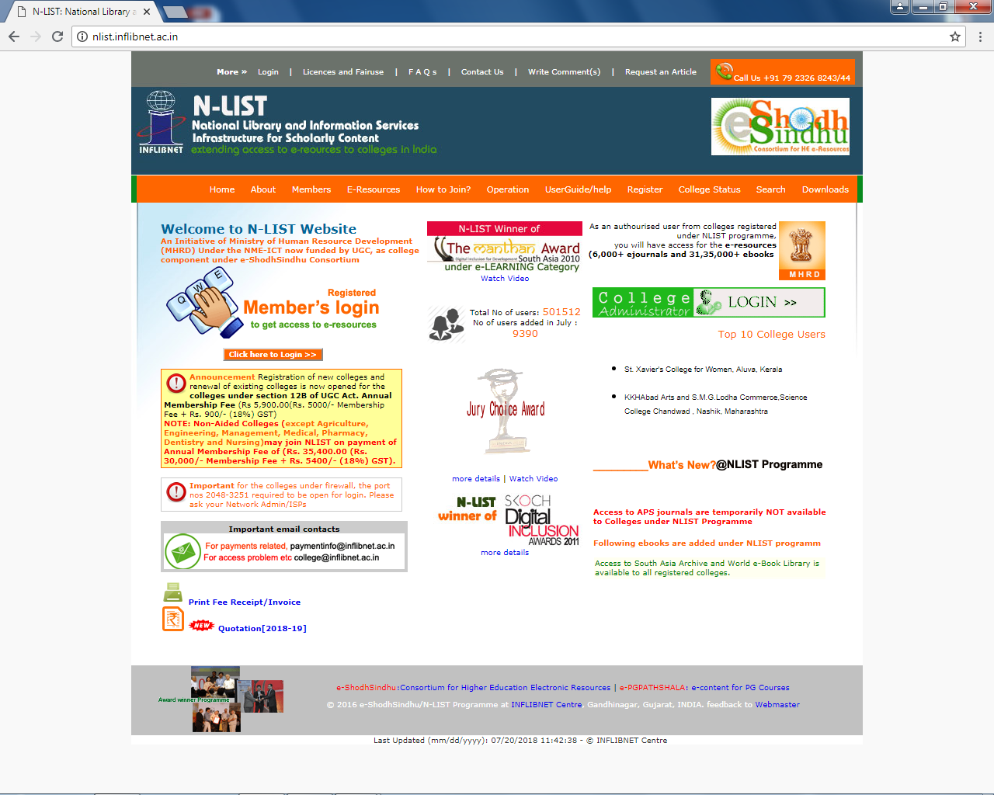
Central Library
INFLIBNET- N-LIST
(Online Journals)

Slide 49
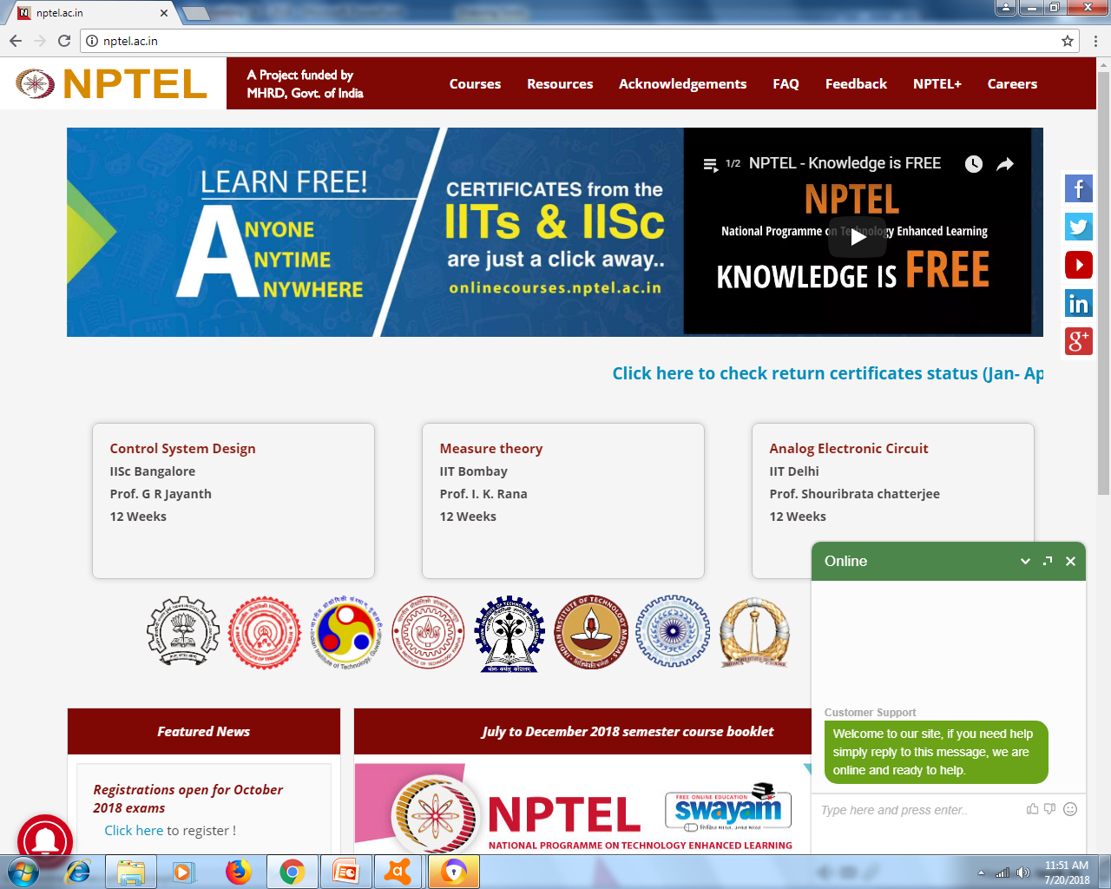
Central Library
NPTEL
(Web and Video Lectures)

Slide 50
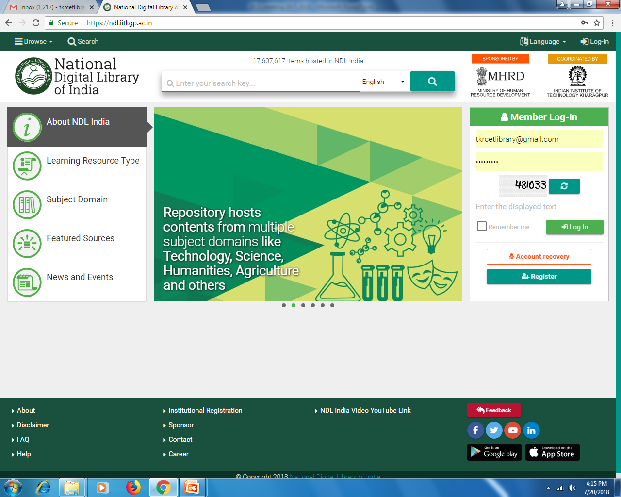
Central Library
NATIONAL DIGITAL LIBRARY
(KG to PG free e-Books)

Slide 51
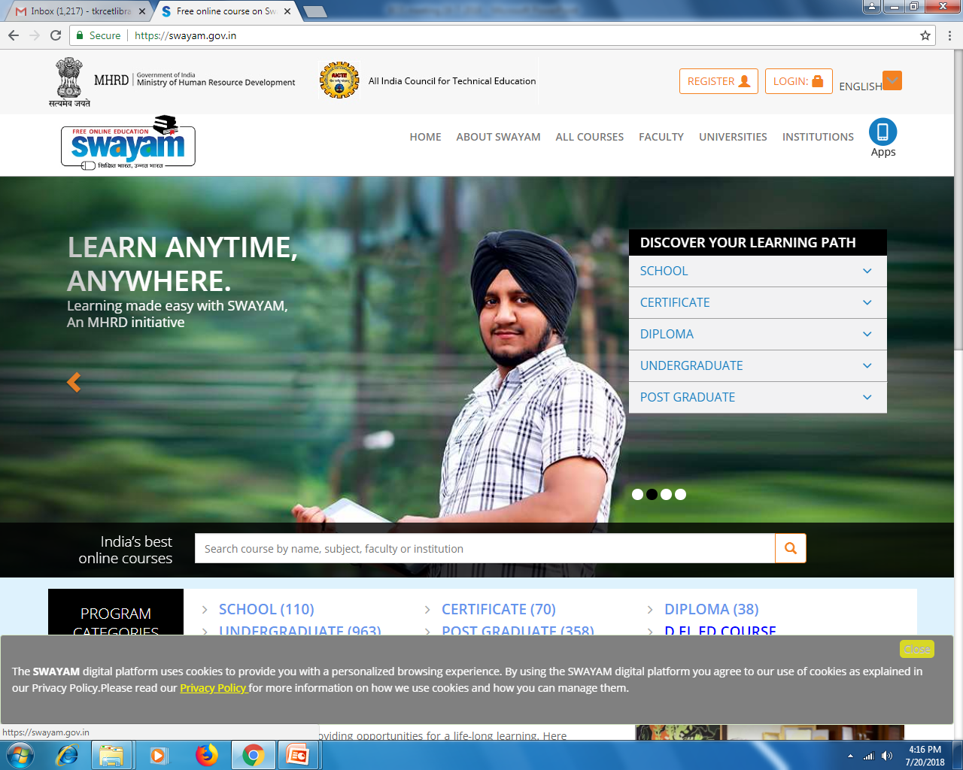
Central Library
SWAYAM
(Study Web An Young Aspiring Minds)

Slide 52
Central Library
Institutional Membership
IEEE -Institute of Electrical & Electronics Engg
DELNET -Developing Library Network
INFLIBNET -Information Library Network
NDL -National Digital Library
NPTEL -National Programme on Technology
Enhanced Learning
MOOCS -Massive Online Open Courses
SWAYAM -Study Webs of Active –Learning for
Young Aspiring Minds programme

Slide 53
Central Library
Institutional Repository
Question Banks
Articles Published by the Student
Papers published by the Staff
Academic Calendar
College Information Brochure
Course Handouts
Manuals, Bulletins
Lab Records
Projects / Dissertations

Slide 54
Central Library
User Orientation
IEEE Subscription
User Orientation
Extended Hours
New Arrivals
Book Bank
Book Bank Scheme
Services
&
Facilities
Library Services & Facilities
Welfare Collection
Xerox/ Print/Scanning
Competitive Books
Reference Service
Syllabus
Question Papers
Reference Service
e-Learning
NPTEL, NDL
SWAYAM
N-List

Slide 55
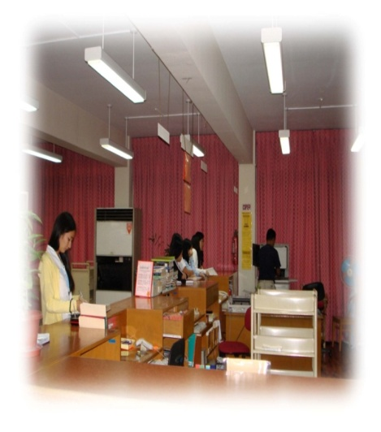
Central Library
Services:
Circulation
Reference / Research
Automated Library Operations
Book Bank Facility
Inter Library Loan
Information Alert Service
Photo copy / Scanning / Printing
Web Based Service
User Awareness Programme
New Arrivals Display
Career guidance, Competitive Books Service
Selective Dissemination of Information

Slide 56
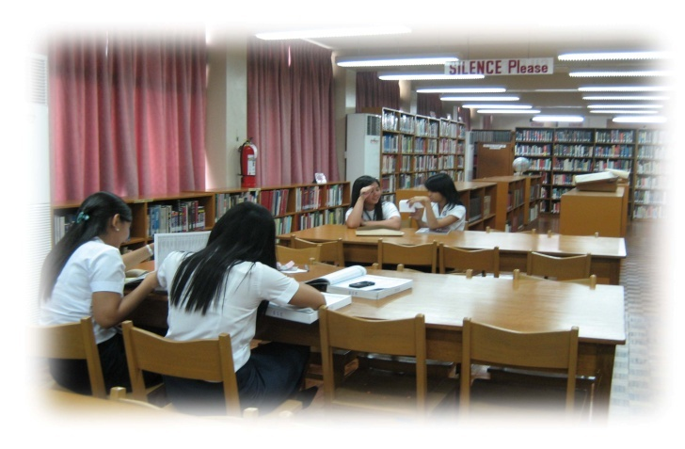


Central Library
Facilities:
Open Access
OPAC(online Catalogue)
Computerized Services
Smart cards for members
Digital Library Service
Book Bank Facility
Over night Issues for Reference Books
Mobile and e-Mail Alerts for communication

Slide 57


Central Library
Photo copy / Printing /Scanning
Library & Information Centre provides Reprographic facility to the students and staff This service is provided to users on payment basis for Reference material like,
Books, Periodicals, Question papers Thesis and
Bound volumes etc...

Slide 58
Central Library
Books Arrangement in Library
Two types of Resources are available.
Printing Material-DDC(Classification Scheme)-Books, Journals, Projects
Non-Printing Material-UDC(Classification Scheme)-CD, DVD, Microfilm, Floppy’s
Books in TKRCET Central Library are arranged branch wise, Subject wise(under the Author alphabetical sequence) using under scheme of DDC(Dewey Decimal Classification Scheme). In this system all knowledge is represented by 10 broad subject classes.
Branch indicates Rack Arrangement
Subject indicates Shelve Armament
Example:000 – Computer Science Information and General Works
100-Phylosophy and Psychology
200-Religion
300-Social Science
400-Languages
500-Science
600-Technology and Applied Sciences
700-Arts
800-Literature
900-History and Geography

Slide 59

Central Library
Example,
600-Technology
Each item in the Library as a Unique call number is arranged under that numbers on the Shelves and nose side of the document
620-Engineering and Allied Relations
621-Applied Physics Engineering
622-Mining and related Engineering
623-Military and Nautical Engg
624-Civil Engineering
625-Rail Road Engineering
626-unAssigned
627-Hydrulic Engineering
628-Sanitary and Municipal Engg
629-Other Branches of Engg
630-Agriculture Related Engg
Classification Number

Slide 60
Prescribed
Text & Reference Books
R-20 Syllabus
B.Tech I Year : 2020-21

Slide 61


Central Library
English Communication

Slide 62


Central Library
English Communication

Slide 63


Central Library
Engineering Mathematics

Slide 64


Central Library
Engineering Mathematics

Slide 65


Central Library
Engineering Mathematics

Slide 66


Central Library
Engineering Physics

Slide 67


Central Library
Engineering Physics

Slide 68


Central Library
Engineering Physics

Slide 69


Central Library
Engineering Physics

Slide 70


Central Library
Engineering Chemistry

Slide 71


Central Library
Engineering Chemistry

Slide 72


Central Library
Engineering Chemistry

Slide 73


Central Library
Engineering Drawing / Graphics

Slide 74


Central Library
Engineering Drawing / Graphics

Slide 75


Central Library
Engineering Drawing / Graphics

Slide 76


Central Library
Electronic Devices and Circuits

Slide 77


Central Library
Computer Programming

Slide 78


Central Library
Computer Programming

Slide 79


Central Library
Computer Programming

Slide 80


Central Library
Engineering Mechanics

Slide 81


Central Library
Engineering Mechanics

Slide 82


Central Library
Engineering Mechanics

Slide 83


Central Library
Basic Electrical Engineering

Slide 84


Central Library
Basic Electrical Engineering

Slide 85


Central Library
Basic Electrical and Electronics Engineering

Slide 86
Question Papers
Hard & Soft Copies
Regular & Supply
Soft copy available at Digital Library

Slide 87


Central Library

Slide 88


Central Library
Security Measures :
“CCTV Network(Surveillance) has been fixed in all areas of the Central Library to avoid book theft and other malpractices. The entire Library is arranged WEB Cameras”.

Slide 89
Central Library
Property Counter
Please keep your belongings like Bags, Water
bottles etc.
Don’t leave your valuables.
Eg: Purse / Pouch, Mobiles and Laptop etc
The college authorities will not be responsible for the
loss if any.

Slide 90
Central Library
Rules
ID card is Compulsory for getting access to the library and shown at the Library checkpoint.
No personal belongings allowed inside the library.
Silence to be maintained in the library.
No discussion permitted inside the library.
Membership should be done to become a library member prior to using the library resources.
Text books, printed materials and issued books are not allowed to be taken inside the library.
Documents taken out of the shelves must be left on the table. Replacing the documents on shelves by users is not encouraged as the documents may get misplaced. (…Contd..)

Slide 91
Central Library
8.Using Mobile phones and audio instruments with or without
speaker or headphone is strictly prohibited in the library
premises.
9.Show the books and other materials which are being taken
out of the library to the staff at the entrance counter.
10.Library Borrower cards are not transferable. The borrower is
responsible for the books borrowed on his / her card.
11.The books shall be issued to students for 14 days after
which the same must be returned.
12.If the books are not returned on the due date, an overdue
charge @ Rs 1 per book per day will be charged for the
period, the books are kept beyond the due date.
(…Contd..)

Slide 92
Central Library
13.Books will be reissued for not more than two times. After
that the borrower must return the books.
14.Reference books, Journals / Periodicals, Magazines /
newspapers and other documents declared “For
Reference only” by the library will not be issued
15.A Book Bank facility is available for all the students
16.Suggestions on all aspects of library services are
welcome.
17.Keep the Library clean and neat.

Slide 93
Central Library
Every thing in the library has a
special place.
      Please don’t put Books in the wrong
place.
If you Don’t know where it goes put it on
the return cart.
Always maintain Silence.
Keep it Neat

Slide 94
Central Library
Suggestions
We have part of the suggestion Box at the Library entrance. All Library users Please drop your valuable suggestions at any time.

Slide 95
PHOTO GALLARY

Slide 96





Central Library
Entrance
Inner View
Reading Hall -I
Circulation

Slide 97





Central Library
Reference
Periodicals
Book Bank - I
Book Bank - II

Slide 98





Central Library
Digital Library
Digital Library View
Digital Library View
Stock Area

Slide 99
Central Library
QUESTIONS
AND
CLARIFICATIONS

Slide 100

Central Library
Thank You for Your ATTENTION!
VISIT REGULARLy
Your suggestions are welcome to improve the
services of our Library.

